Slide 1
Social Networks in Love Stories of the Middle-earth
Three unions of the Eldar and the Edain
Kate Nikiforova
Tanya Orlova
Jane Fomenko
Notes:
Three unions of the Eldar and the Edain

Slide 3
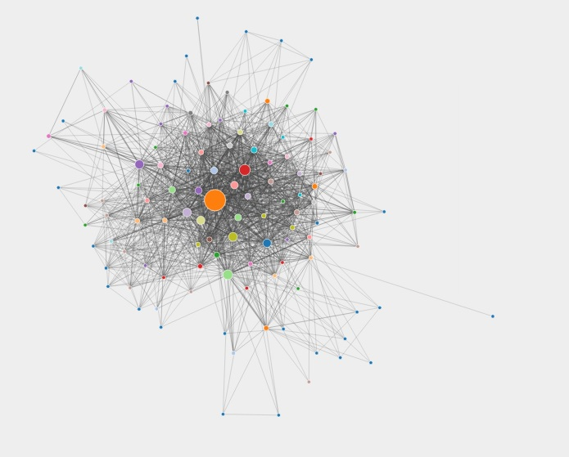
Notes:
http://lotrproject.com/statistics/books/cooccurrences?view=silm but it’s really hard to analyse when it looks like this

Slide 4
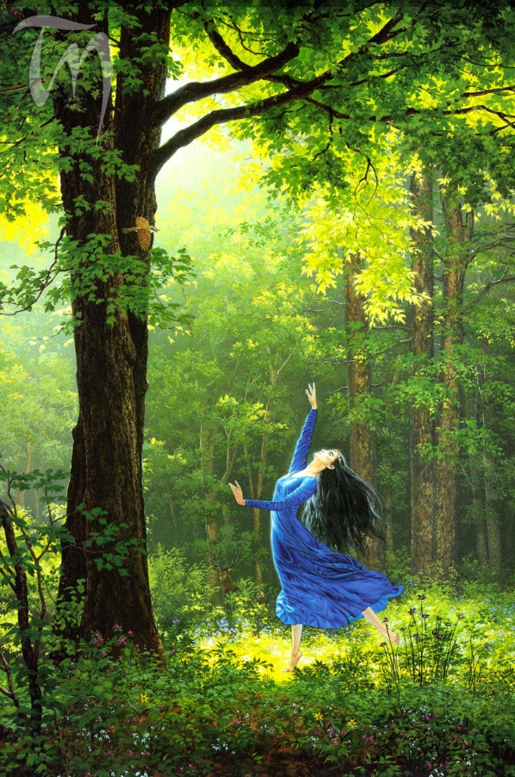
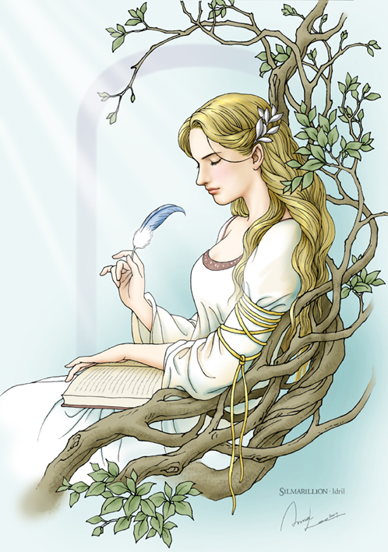
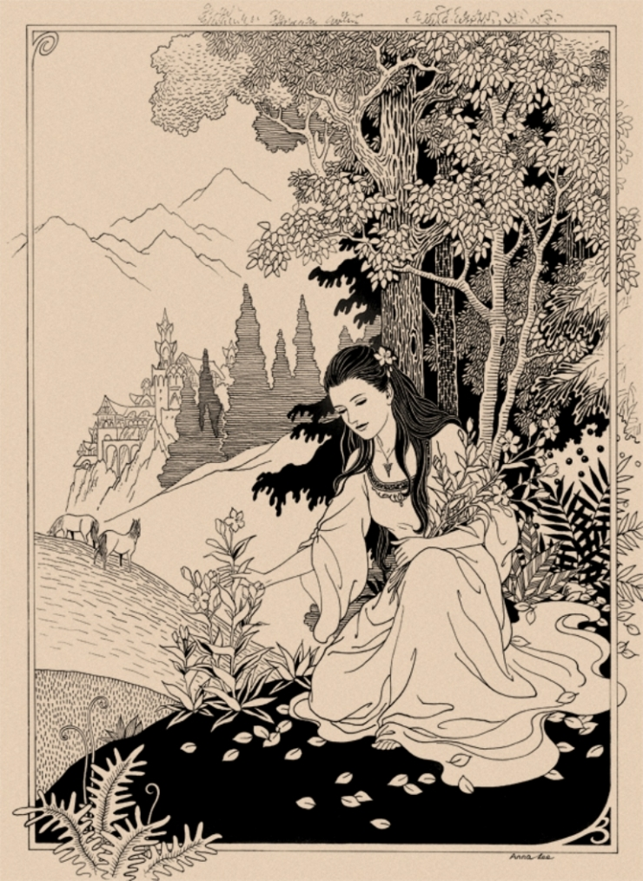
Lúthien Tinúviel
Idril Celebrindal
Arwen Undómiel

Slide 5
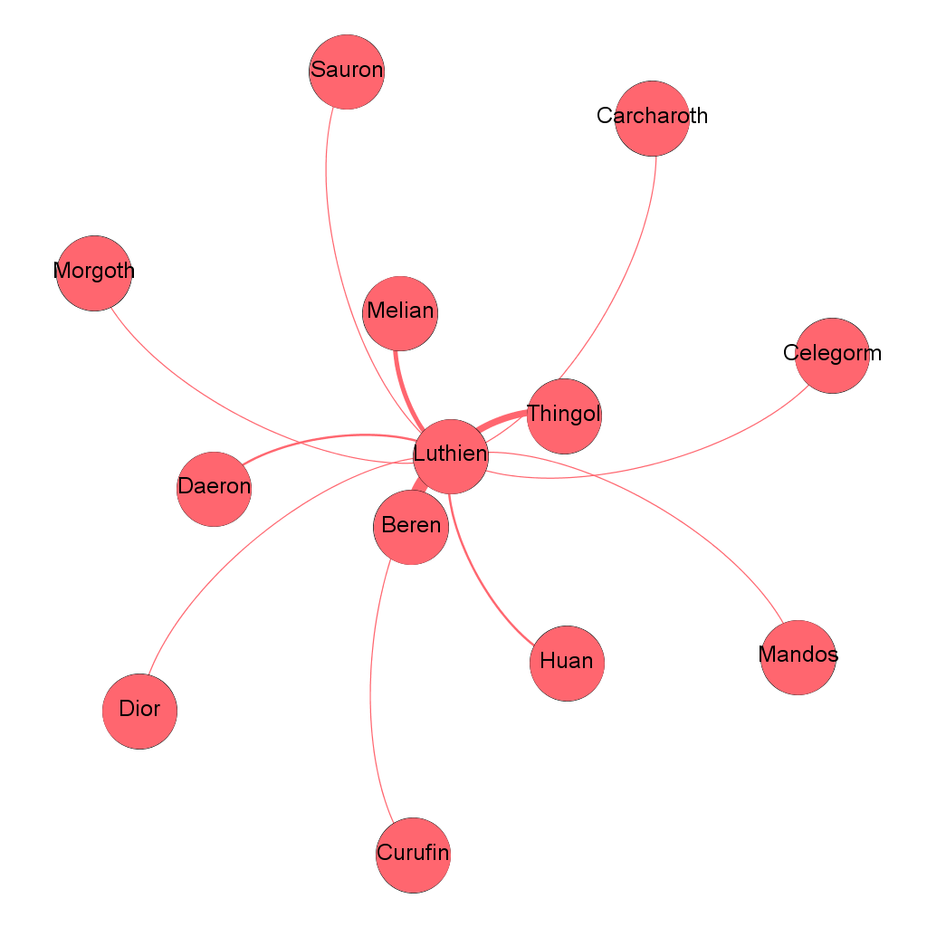
Notes:
Thingol is Luthien’s father
Melian is Luthien’s mother
Beren is her husband
Daeron is the loremaster and minstrel of Doriath, in love with L.
Huan is the Hound of Valinor
Celegorm is a prince of the Noldor
Curufin is Celegorm’s brother
Sauron is chief lieutenant of Morgoth, evil #2
Carcharoth is Morgoth’s wolf
Morgoth is Evil #1, the main antagonist
Mandos is Judge of the Dead and the Master of Doom
Dior is Luthien's son and Thingol’s heir

Slide 6
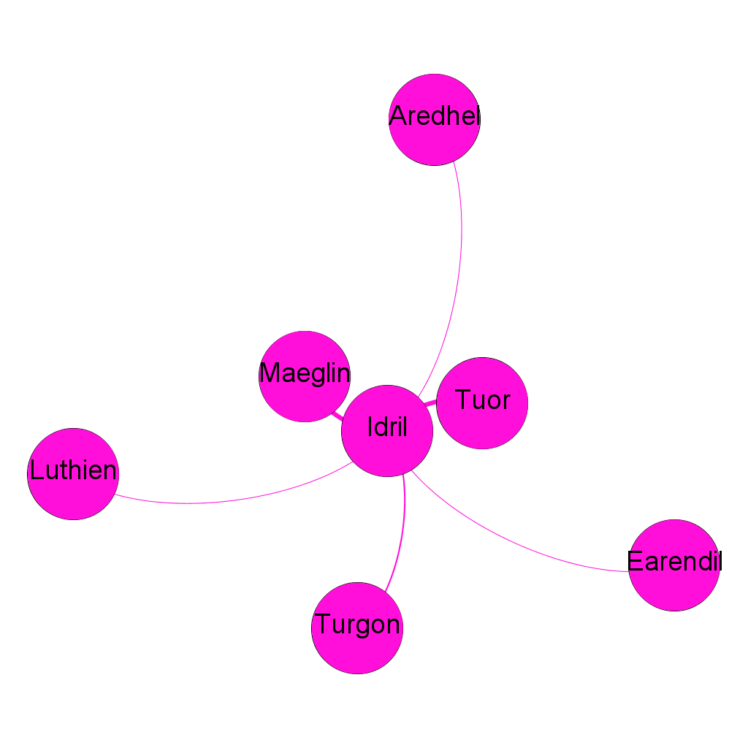
Notes:
Turgon -- Idril’s father
Eol -- Maeglin’s father
Aredhel -- Maeglin’s mother
Maeglin -- Idril’s cousin, in love with her
Tuor -- Idirl’s husband
Earendil -- Idirl’s son

Slide 7
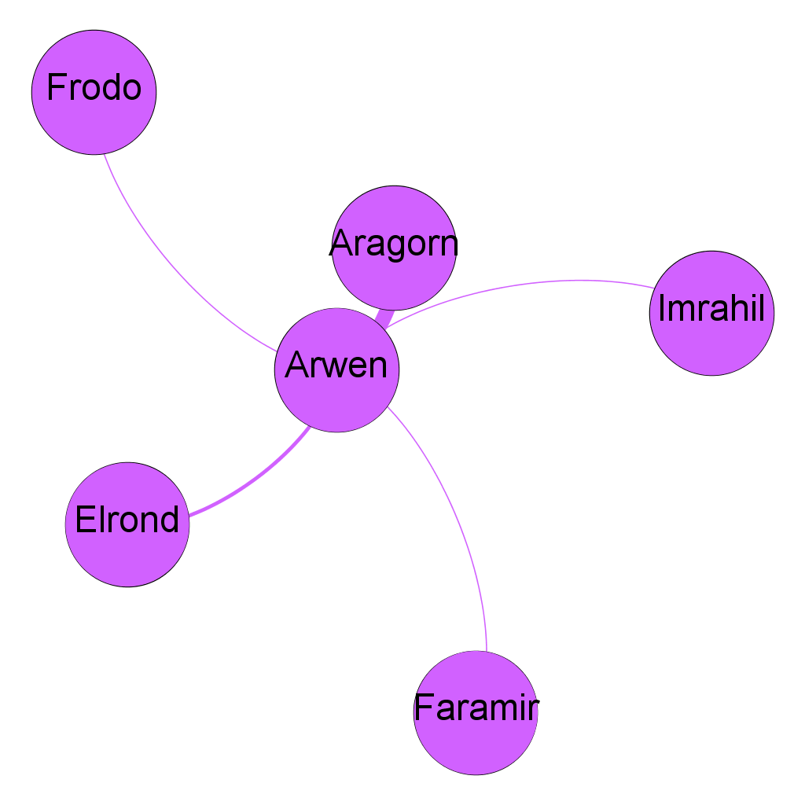
Notes:
Aragorn, also known as Elessar, is the king and Arwen’s lover
Elrond is Arwen’s father
Frodo is known by everyone, surely
Faramir is the captain of the Rangers of Ithilien
Imrahil is the twenty-second Prince of Dol Amroth

Slide 9
Beren & Luthien

Slide 10
Program vs Manual

Slide 11
Problems
Too messy
No dialogs
How to decide what nodes to connect?

Slide 12
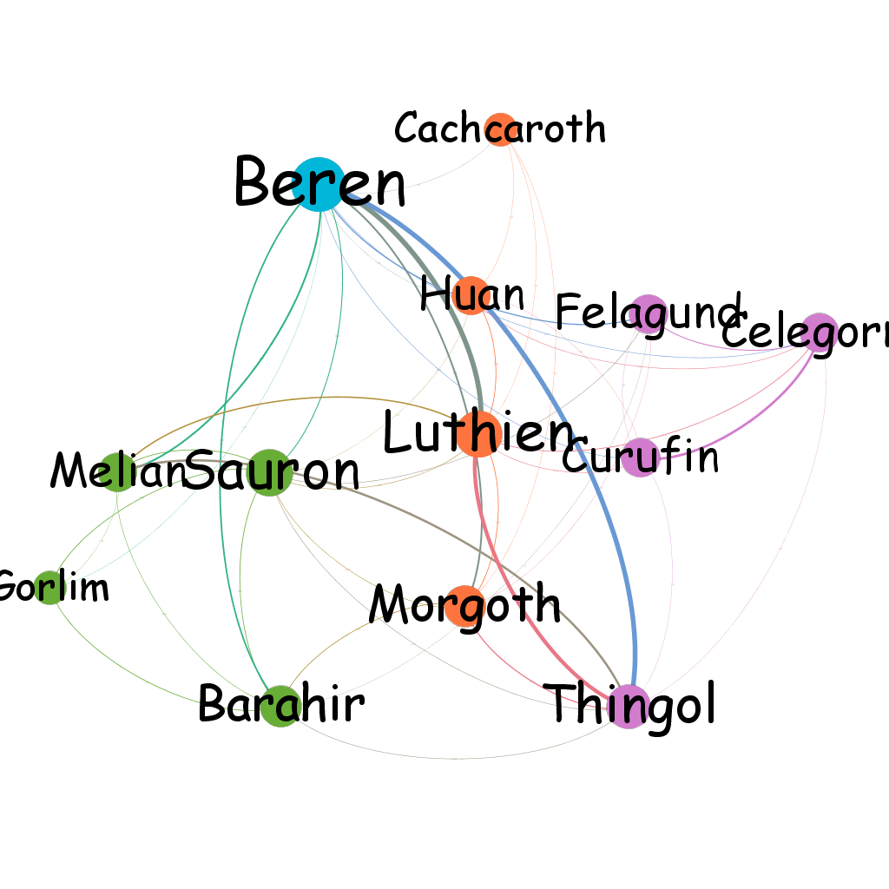

Slide 13
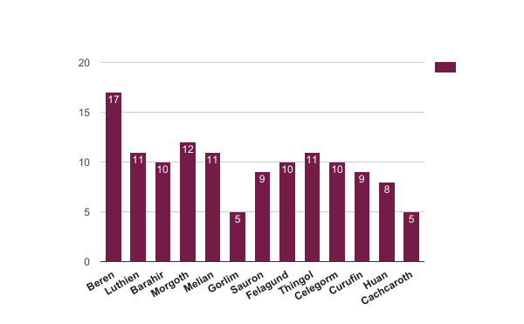

Slide 14
