Slide 1
Slaves in Ancient Greek tragedy: visual analytics

Slide 2
The Ancient Greek culture tends not to classify slaves as the part of the community
“the barbarian and the slave were by nature one” (Aristotle, “Politics”, 1252b)
In Greek tragedy, there are some slave characters. We analyzed six tragedies supposing that the slaves may have a distinct role in the plot comparing to other characters (principal or secondary)
Their distinction may be quantitatively expressed by their extraordinary position in the network
We made a network for each tragedy. A speech act is counted as a link; the weight of the link is the number of interactions in different acts of the tragedy

Slide 3
Eschil’s “Agamemnon”

Slide 4
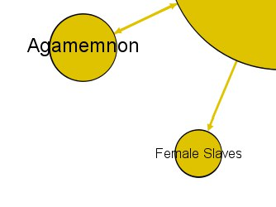
Eschil’s “Agamemnon”
The slave is separated from the others and is connected only to the lead character (Clytemnestra)
It doesn’t speak: it is the feature that distinguishes the slave from the secondary characters
The other slave has a small monologue; in fact, it doesn’t take part in the tragedy as a legitimate character

Slide 5
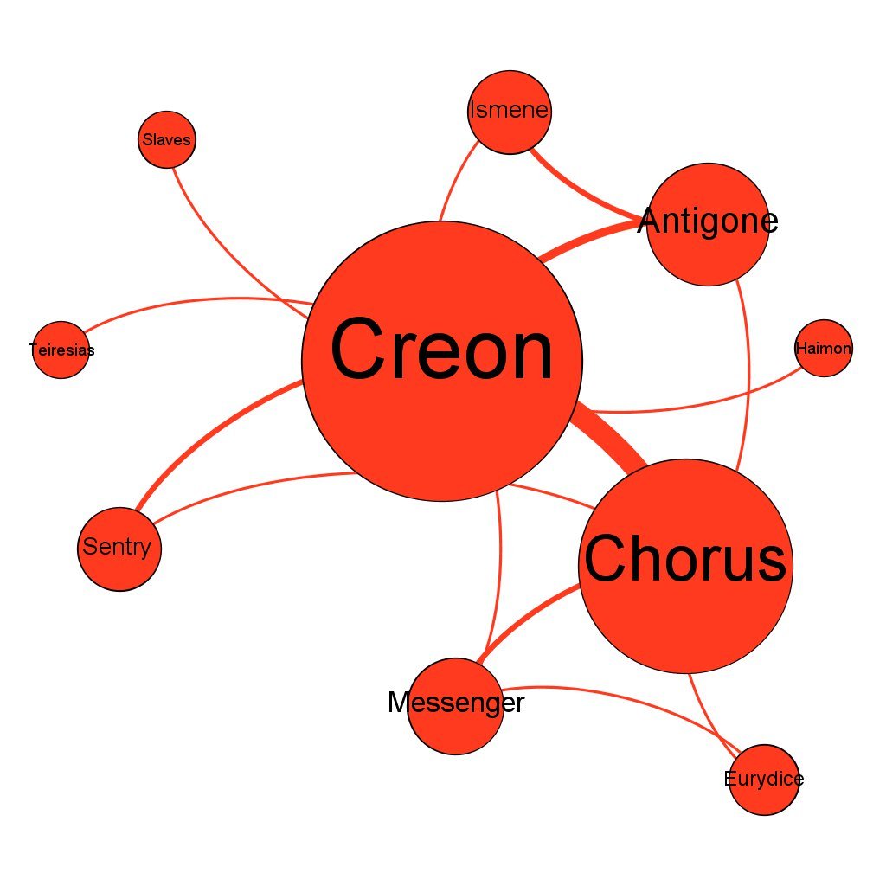
Sophocles’ “Antigone”

Slide 6
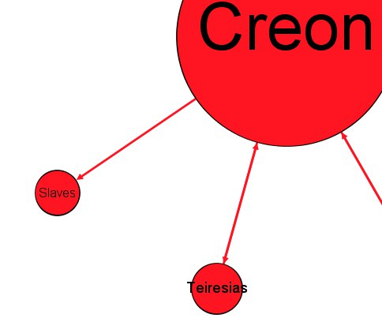
Sophocles’ “Antigone”
The slave doesn’t speak; it is just the intention of other speech acts
It is connected only to the main character (Creon)
Three characters which have only one link are Slave, Teiresias and Haimon, but the last two have a certain number of speech acts

Slide 7
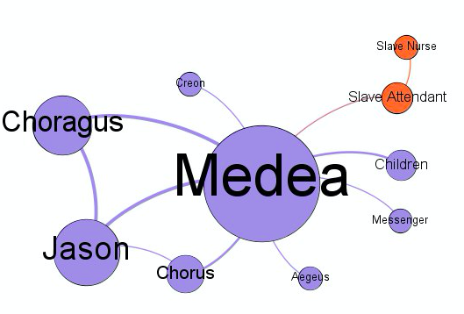
Euripides’ “Medea”

Slide 8
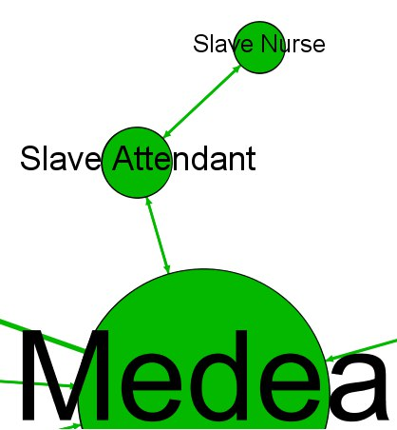
Euripides’ “Medea”
The slaves are clusterized
Only the slave attendant speaks to the protagonist but the slaves intercommunicate
They open the play (the same is in “Agamemnon”)
Slave attendant is closer to the centre as he’s more important to the plot

Slide 9
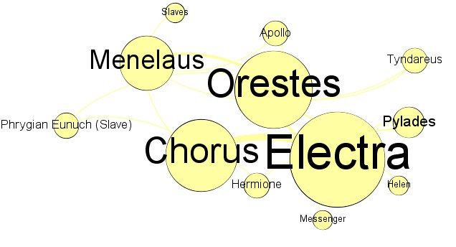
Euripides’ “Orestes”

Slide 10
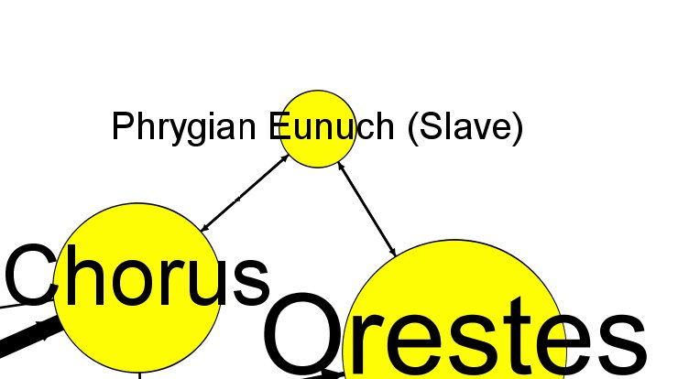
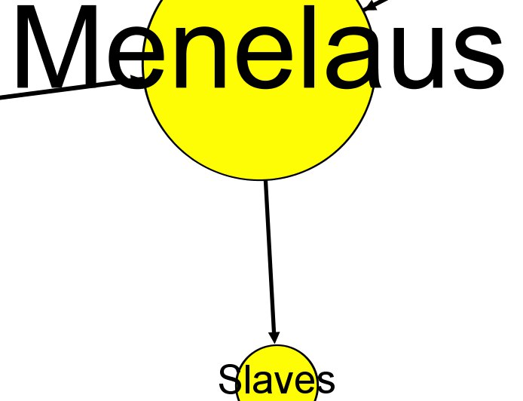
Euripides’ “Orestes”
The structure is specific: most secondary characters have two or more communication acts
The Phrygian Eunuch is a legitimate character of the tragedy despite being a slave: he has two links and he’s not even called a slave
The “real” slaves don’t speak: their only appearance in the tragedy is an irresponsive order

Slide 11
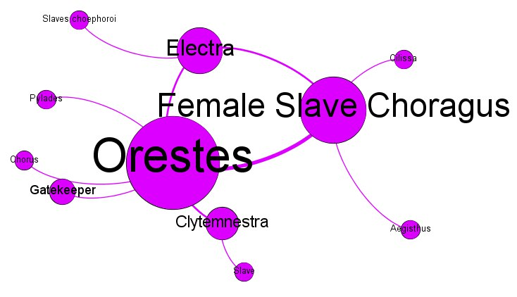
Eschil’s “The Libation Bearers” (“Choephoroi”)

Slide 12
Eschil’s “Choephoroi”
The lead character is a female slave chorus leader but only as it represents the whole chorus
The status of the slave is evident in the tragedy’s beginning but later it becomes implicit
Another slave character is peripherical: the only character which is not connected to the three key figures but nevertheless he is speaking

Slide 13
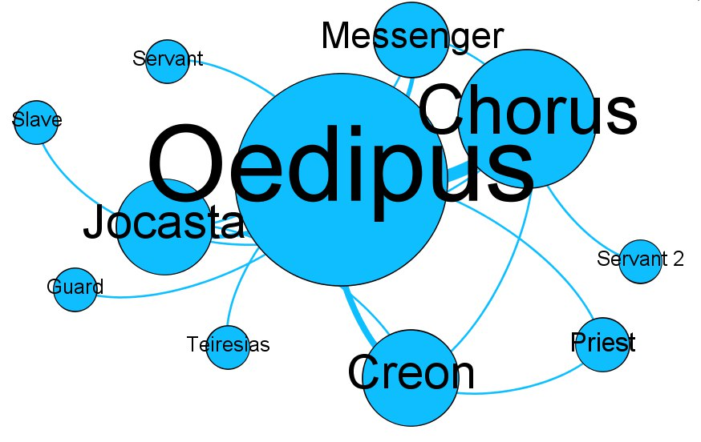
Sophocles’ “Oedipus The King”

Slide 14
Sophocles’ “Oedipus The King”
The biggest number of slaves (4)
Three of them are servants: their functions in the plot are specified
Servants speak because they all have a message for the protagonists
The only “classic” slave is far from the network centre and speaks to a secondary character

Slide 15
Summary
According to the graphs, we can conclude that slaves in Ancient Greek tragedy have an intermediate position: they’re not totally excluded from the plot but generally have a lesser role than other characters
A typical portrait of a slave in a tragedy:
doesn’t speak
doesn’t have a name
usually appears in non-significant parts of the plot
connected only to one of the characters
located far from the network centre

