Slide 1
Collaboration Network Of modern American hip-hop

Slide 2
Overall mapping
3 clusters:
New York
Georgia
California

Slide 3
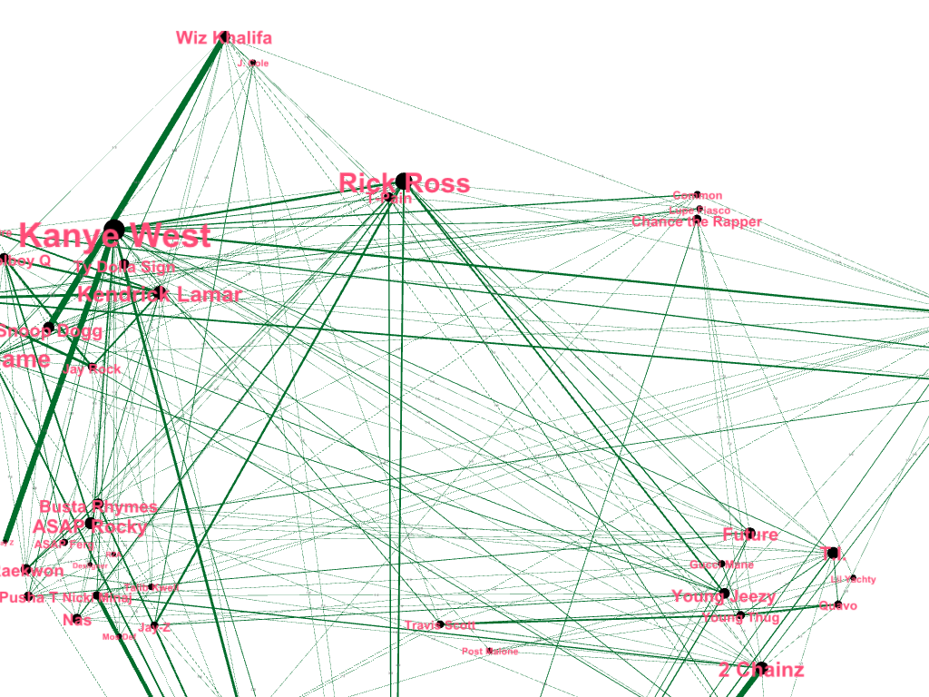

Slide 4
New York cluster

Slide 5
Georgia Cluster

Slide 6
California cluster

Slide 7
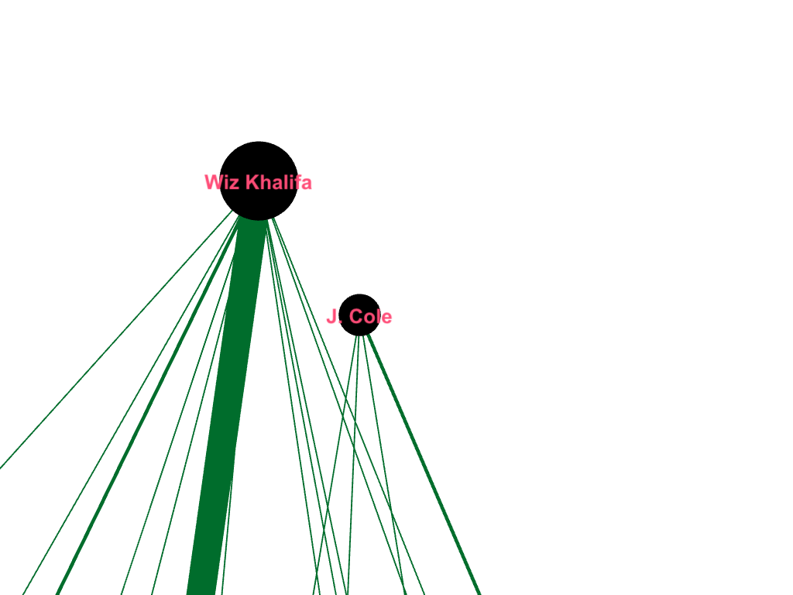
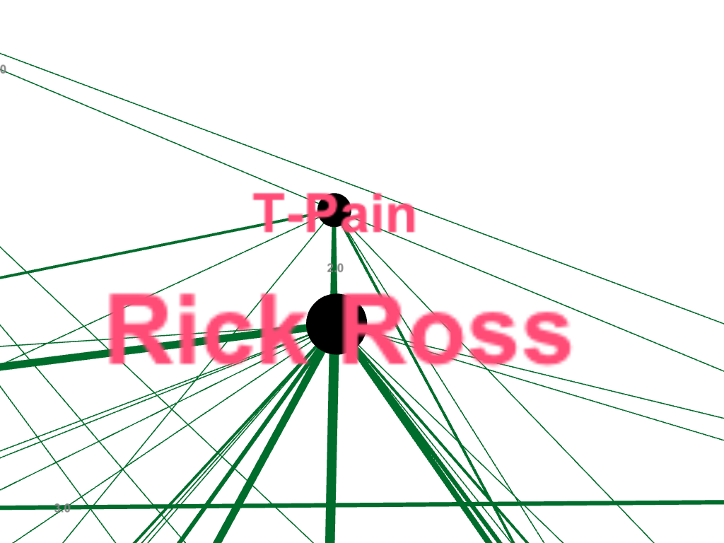
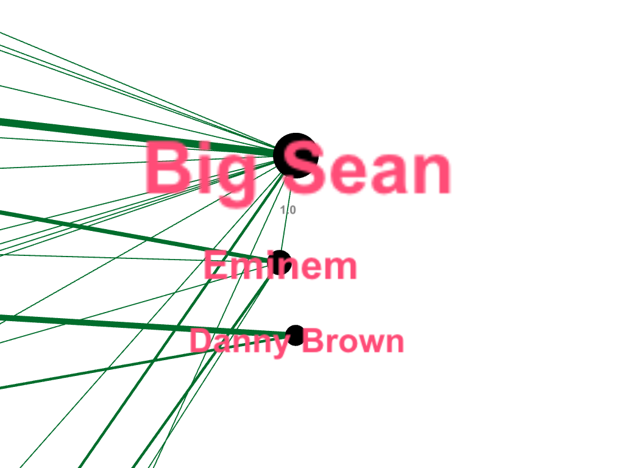
N.
D
A
K
T
A
FLOR
IDA
I
L
L
I
NOI
S
M
I
CH
I
GAN

Slide 8
Can the amount of collaborations be an indicator of success?
Yes and No.
It depends on the specification of artist’s style.

