Slide 1
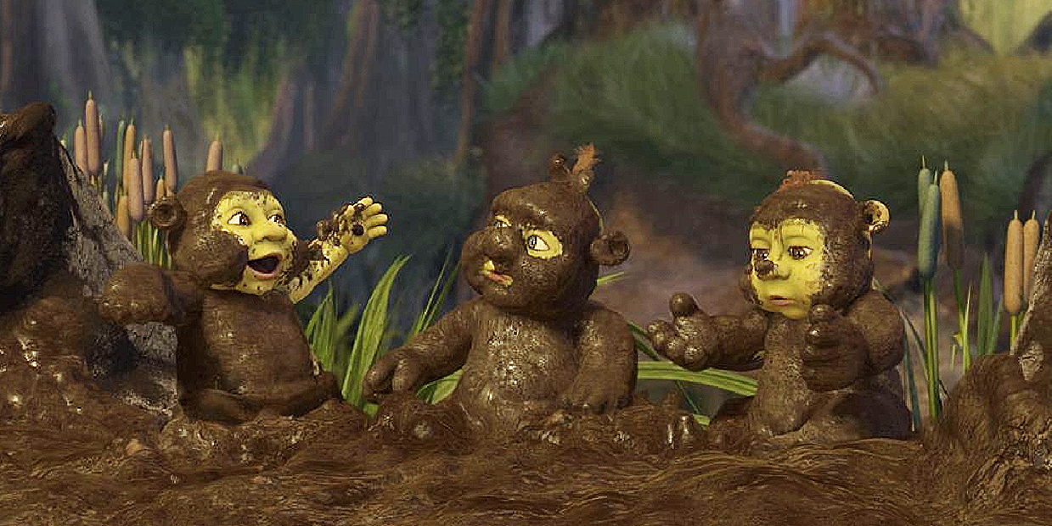
Threshold and Network Generalizations of Muddy Faces Puzzle
Denis Fedyanin
dfedyanin@inbox.ru
Researcher in Laboratory 57 (“Active systems”)
Institute of Control Sciences, Moscow, Russia
Russian Academy of Science

Slide 2
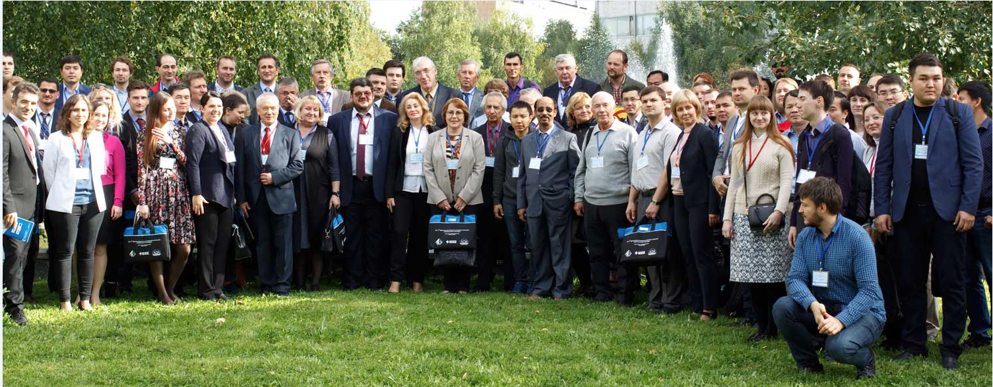
11th IEEE International Conference on Application of Information and Communication Technologies 2017, Moscow, Russia

Slide 3
The basic story of the puzzle is as follows. Three children have muddy faces, and each can see the others’ faces, but not his own. A teacher announces to the children: "at least one of you has a muddy face". Then he asks: "Do you know whether your face is muddy or not? If so, raise your hand". No child raises a hand. Then, after some time, the teacher asks the same question, and again no child raises a hand. Some more time passes, and when asked the question a third time, each child raises his hand.

Slide 4
Littlewood (1953). A mathematician's miscellany. London: Meuthen.
Lefebvre V.A. Conflicting Structures. – Moscow: Soviet Radio, 1973. – 158 p. (in Russian). The Structure of Awareness: Toward a Symbolic Language of Human Reflexion. – NY: Sage Publications, 1977. – 199 p.
Granovetter, Mark, “Threshold Models of Collective Behavior,” American Journal of Sociology, (1978), 83, 489–515.

Slide 5
Hintikka J., Reasoning about Knowledge in Philosophy: The Paradigm of Epistemic Logic . J. Symbolic Logic 53 (1988), no. 2, 663—664
Aumann R.J. Interactive epistemology I: Knowledge// International Journal of Game Theory. August 1999, Volume 28, Issue 3, pp 263–300
Lenzen, W. Recent work in epistemic logic. _Acta Philosophica Fennica_ 30 (2): (1978). 1-219.

Slide 6
Suk-Young Chwe, M., Communication and Coordination in Social Networks. The Review of Economic Studies, Vol. 67, No. 1, (2000). Pages 1-16
Ghallab M., Nau D.S., Traverso P.. Automated Planning: Theory and Practice. Morgan Kaufmann, 2004. 635 pages.
van Benthem J., Erratum: "Rational dynamics and epistemic logic in games" // Int. Game Theory Rev., 09, 377 (2007). Pages 13–45

Slide 7
Gerhard Brewka, Ilkka Niemelä, Miroslaw Truszczynski: Nonmonotonic Reasoning. in Handbook of Knowledge Representation. Foundations of Artificial Intelligence 3, Elsevier 2008, 239-284.
Shoham Y., Leyton-Brown K.. 2008. Multiagent Systems: Algorithmic, Game-Theoretic, and Logical Foundations. Cambridge University Press, New York, NY, USA.
Paweł Garbacz, Piotr Kulicki, Marek Lechniak, Robert Trypuz A Formal Model for Epistemic Interactions // New Challenges in Computational Collective Intelligence Volume 244 of the series Studies in Computational Intelligence pp 205-216

Slide 8
Gierasimczuk N., Szymanik J.. A note on a generalization of the Muddy Children puzzle. Proceeding TARK XIII Proceedings of the 13th Conference on Theoretical Aspects of Rationality and Knowledge. Groningen, The Netherlands — July 12 - 14, (2011). 257-264
Guillaume Aucher and Thomas Bolander. 2013. Undecidability in epistemic planning. In Proceedings of the Twenty-Third international joint conference on Artificial Intelligence (IJCAI '13), Francesca Rossi (Ed.). AAAI Press 27-33
Kline J.J. Evaluations of epistemic components for resolving the muddy children puzzle// Economic Theory. May 2013, Volume 53, Issue 1, pp 61–83
Novikov D.A., Chkhartishvili A.G. Reflexion and Control: Mathematical Models // Communications in Cybernetics, Systems Science and Engineering, CRC Press, (2014), 298 pages

Slide 9
van Benthem J., van Eijck J., Gattinger M., Su K. Symbolic Model Checking for Dynamic Epistemic Logic. In: van der Hoek W., Holliday W., Wang W. (eds) Logic, Rationality, and Interaction. Lecture Notes in Computer Science, vol 9394. Springer, Berlin, Heidelberg, (2015). 366-378
Silver, D., Huang, A., Maddison C. J., Guez A., Sifre L., Driessche G. van den, Schrittwieser J., Antonoglou I., Panneershelvam V. (2016). "Mastering the game of Go with deep neural networks and tree search". Nature. 529 (7587): 484–489. doi:10.1038/nature16961
Breer V.V., Novikov D.A., Rogatkin A.D. Mob Control: Models of Threshold Collective Behavior. Series: “Studies in Systems, Decision and Control”. – Heidelberg: Springer, (2017). 134 p.

Slide 10
Faces of three children
Epistemic Logic
Graphs
Farkle Fergus Felicia
Modal Logic
Finite state automata
Kripke model
Discrete optimization
Reflection
Numerical methods
Reasoning
Diagrams
Games
Epistemic planning
Uncertainties
Information control
Multi-agents system
Social networks
Decision making
Dynamic games
Active systems
Graphical representations
Consensus
Haskell
MATLAB

Slide 12
Possible worlds, logic and messages
We consider n binary parameters of a world.
Number of all possible worlds is finite and limited by upper bound $2^{n}$.
We consider arbitrary message φ that can be either true or false in each possible world.
Anyone can check if φ is true or false in each possible world at any time.
If one makes a public announcement φ then anyone who believes that it is true can conclude that worlds where φ is false are not possible any more.

Slide 13
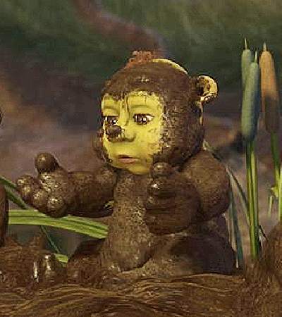
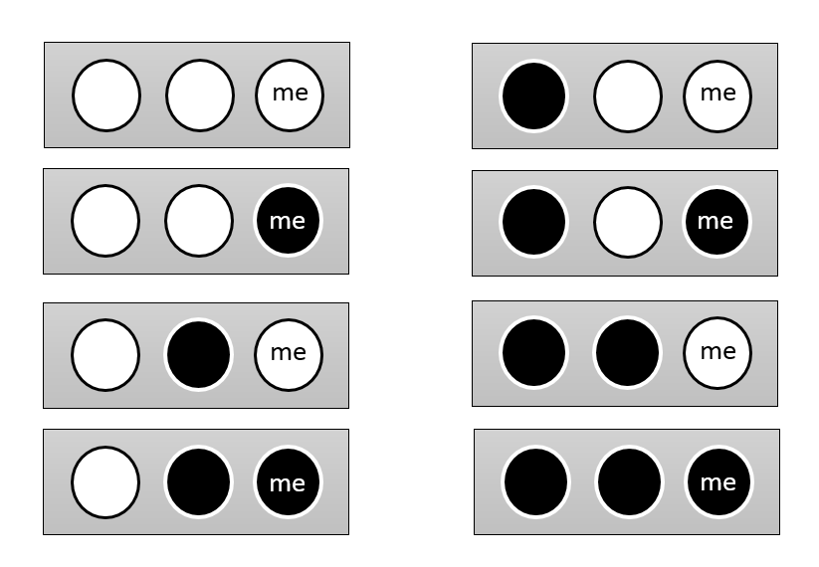
Possible worlds in a reflection of Felicia
Farkle Fergus Felicia
Farkle Fergus Felicia
Farkle Fergus Felicia
Farkle Fergus Felicia

Slide 14
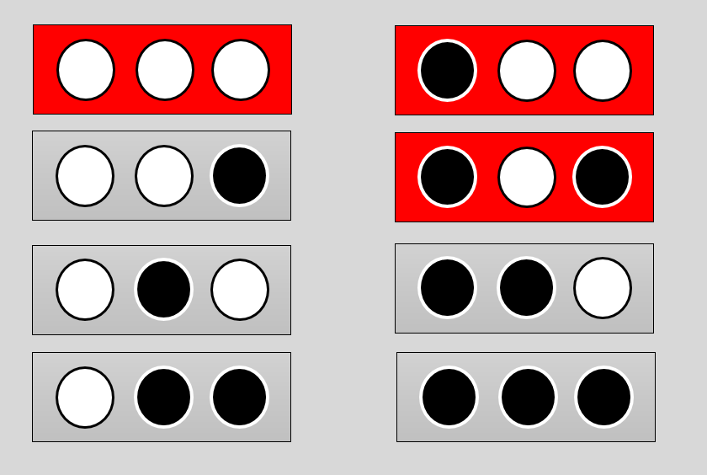
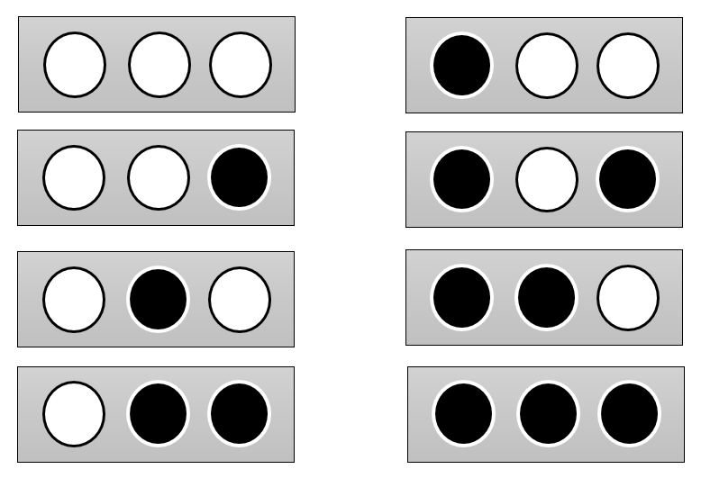
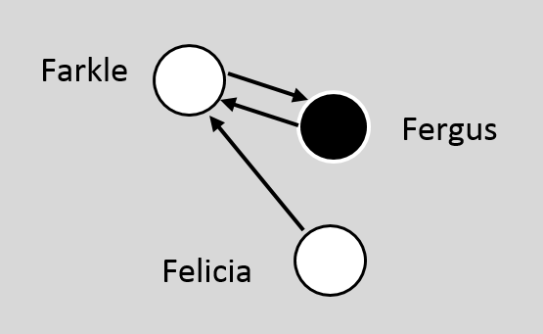
Farkle
Fergus
Felicia

Slide 15
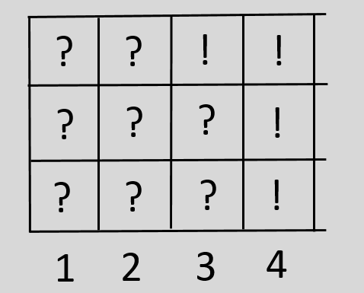
History of activity matters
Farkle
Fergus
Felicia
Iteration
Farkle Fergus Felicia

Slide 16
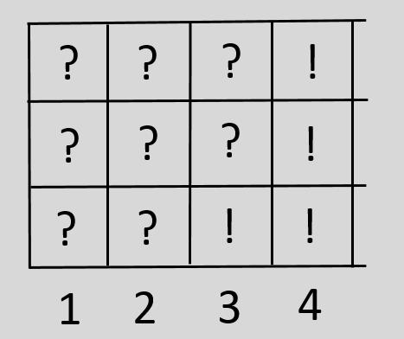
Epistemic planning
What network (edges) and message φ (red squares) chose to find get target history of activation?
?
Farkle Fergus Felicia
?
What if fix number of edges and red squares?
And what if we will look for a minimum iteration
for activation of all players?

Slide 17
Monotone?

Slide 18
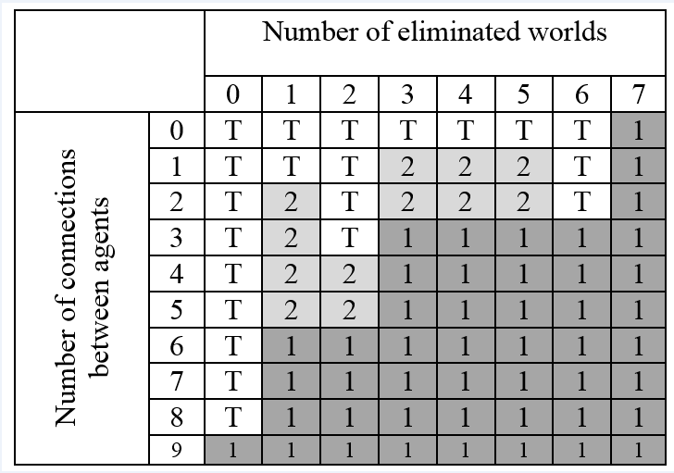
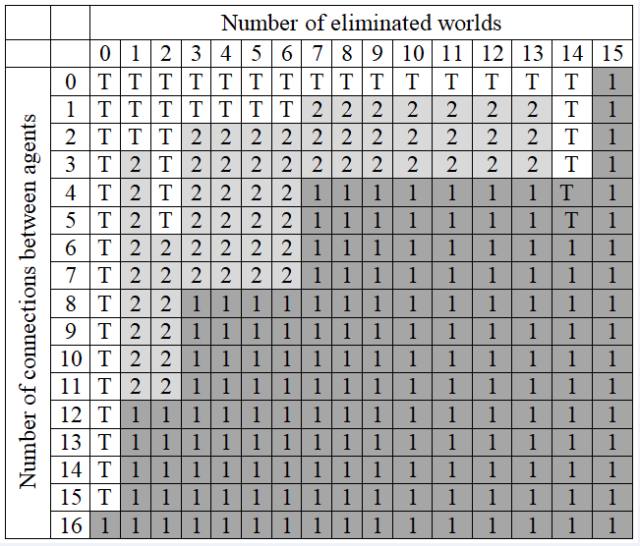
Numerical optimization (by MATLAB)

Slide 19
Moving to Threshold generalization.

Slide 20
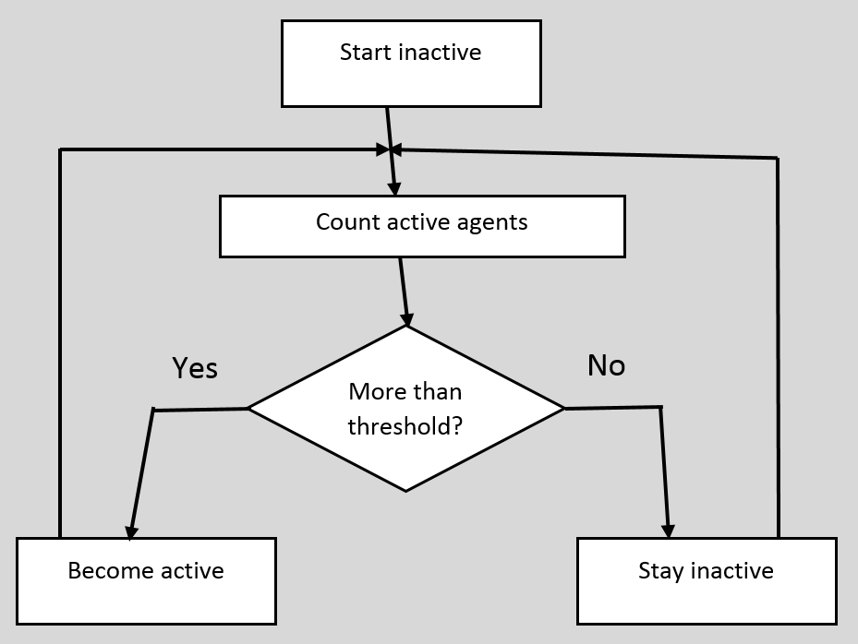
Idea of Thresholds

Slide 21
Example of a decision making process based on Thresholds
Possible worlds
So, at least one muddy but not sure about two
So, not sure that there are more then 2 muddy faces
Felicia
So, no activity

Slide 22
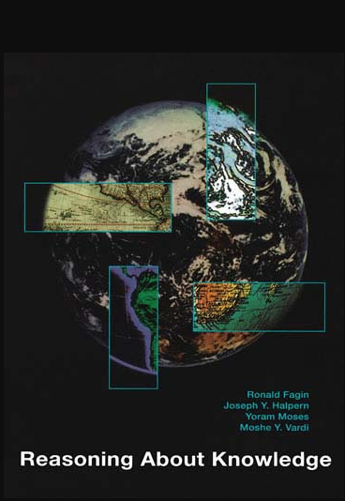
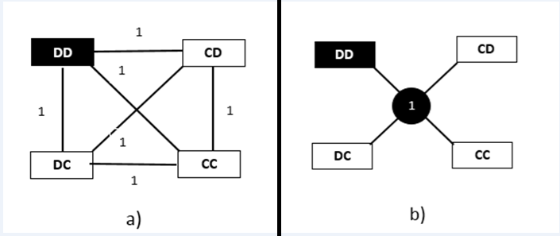
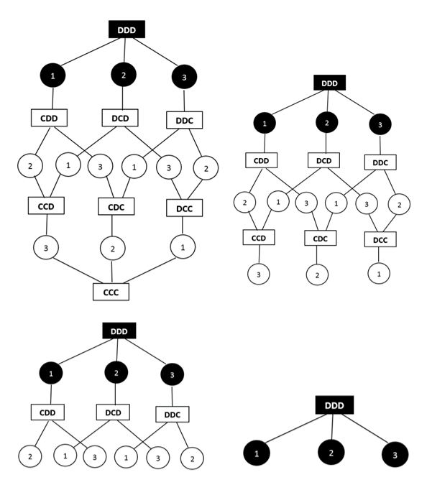

Slide 23
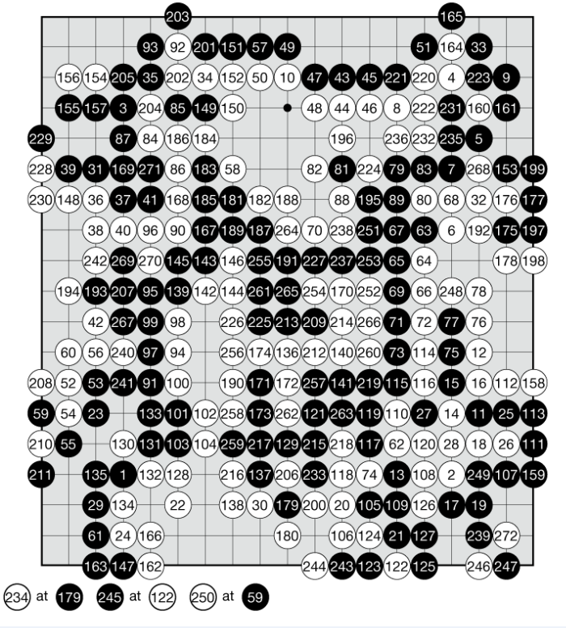
+

Slide 24
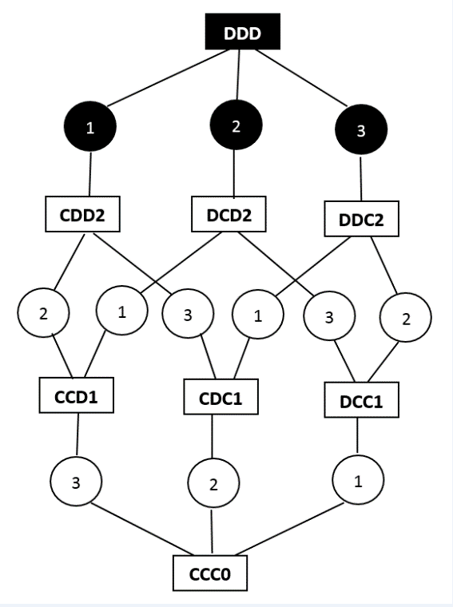

Slide 25
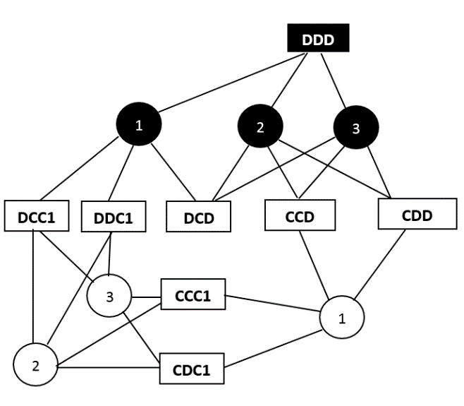
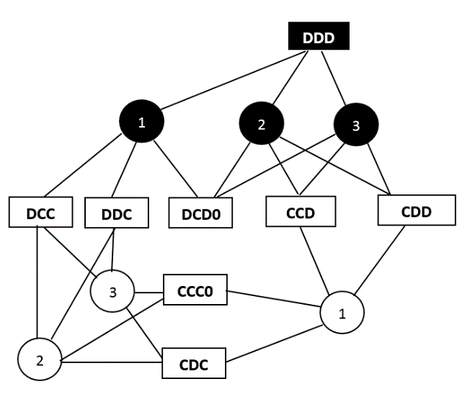
Examples: Initial observations: the 1st agent knows if his/her own face is muddy, the 2nd and the 3rd agents know if the face of the 3rdone is muddy. Thresholds = (3, 2, 1).

Slide 26
Thank you for your attention
Please feel free to ask questions.

