Slide 1
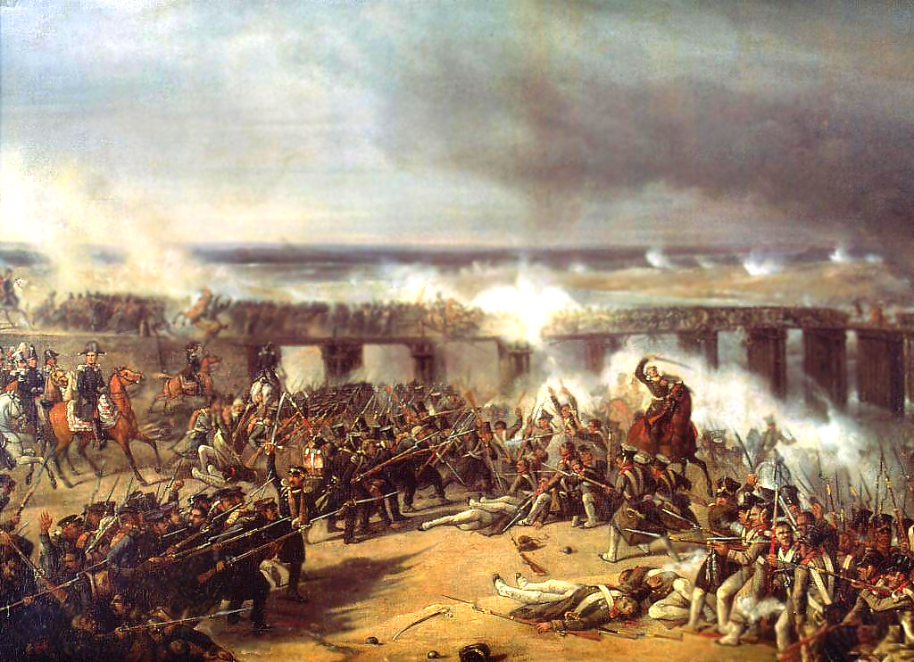
The Battle of Ostrołęka 26th May 1831
Arkadiusz Bożejewicz,
Nicolaus Copernicus University in Toruń

Slide 2
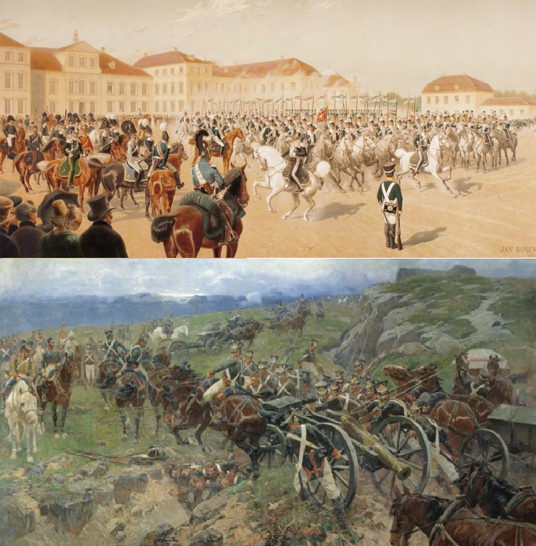
Circumstances. Russian and Polish armies
After the Napoleonic Wars, the Duchy of Warsaw was liquidated. Most of its lands, under the name of the Kingdom of Poland, found themselves within the borders of the Russian Empire, where they received extensive autonomy, retained their former administration, rights and a well-trained army of post- Napoleonic Polish officers. Although the Kingdom enjoyed formal independence and its constitution was one of the most liberal in Europe at the time, opposition was growing against the rule of tsarist governors, and above all the Grand Duke Konstantin Pavlovich Romanov. Dissatisfaction was also caused by violations of the constitution, rising taxes, and an extensive network of secret police. However, the direct cause was revolutions in France and Belgium. As a signatory of the Holy Alliance, Russia announced that the Polish army would be sent to Belgium.
Due to earlier abuses of tsarist officials, it was feared that when the Polish army left the Kingdom, Tsar would introduce a state of emergency and incorporate Poland into the Empire as another governorate. On the night of November 29-30 1830, a group of cadets carried out a successful coup d'état in Warsaw, called the November Uprising in Polish historiography. Russian troops withdrew from the Kingdom, and Duke Konstantin was evacuated. On January 25, 1831, the Sejm of the Kingdom announced the dethronement of Tsar Nicholas I, which canceled attempts to reach agreement and became the cause of the outbreak of the Polish-Russian war of 1831. Quite unexpectedly, the Russian army was not able to defeat the weaker but well-trained insurgent troops. On February 14, 1831, the Russian avant-garde was defeated in a skirmish at Stoczek, and on February 25, 1831, after the unresolved battle of Grochów, they withdrew from Warsaw, giving Poles time to regroup and prepare a counteroffensive. This began with Polish successes: March 31, 1831 near Dębie Wielkie; October 10, 1831 near Iganie.

Slide 3
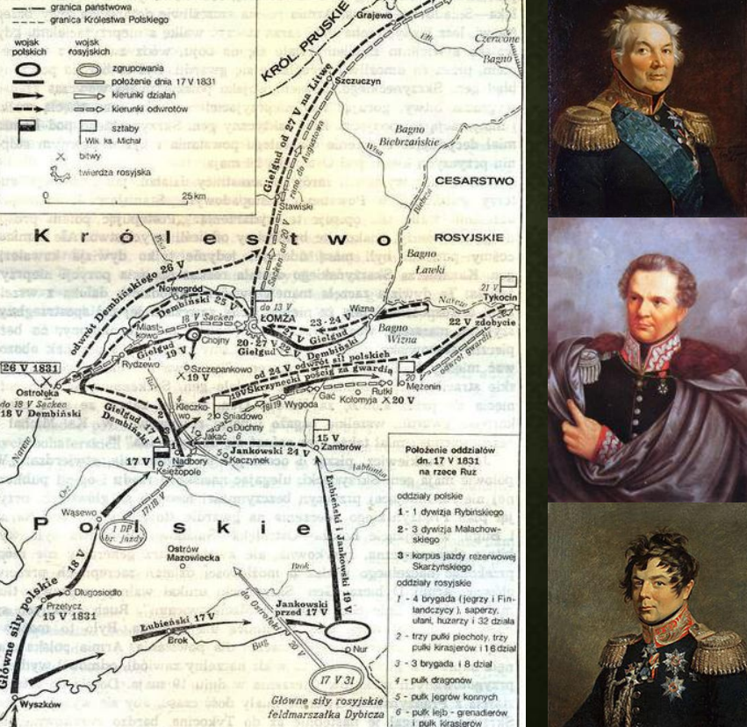
To the guard
The situation of Poles became so favorable that troops were even sent to start an uprising in the Belorussian, Lithuanian and Ukrainian governorates located at the rear of the Russian army. In order to take advantage of the initial successes and the dispersion of Russian troops, the Kingdom’s staff planned an operation known in historiography as a "expedition to the guard." It was an elite unit in the Russian army, consisting of sons of aristocracy. It was intended to take the guards prisoners so that they could exert pressure on the tsar through the Russian aristocracy and negotiate a favorable peace. It was known that the Guard was stationed in Ostrołęka, far away from the main Russian forces. The first clash took place from 17 to 18 V. Then the guard found itself at a disadvantage - no retreats, almost encircled by the Polish army and given a slight advantage of the opponent: 28,000. Poles and 80 guns faced 24,000. Russians and 72 guns. Fortunately for the Russians, due to the negligence of General Skrzynecki, not only the advantage was not used, but the attack was stopped and the guards were allowed to join the remaining Russian forces.
The Battle of Ostrołęka, which was fought on May 26, 1831, had a different power ratio: 30,000. Poles and 74 guns were to face 35,000 Russians and 148 guns, which already use much better terrain.

Slide 4
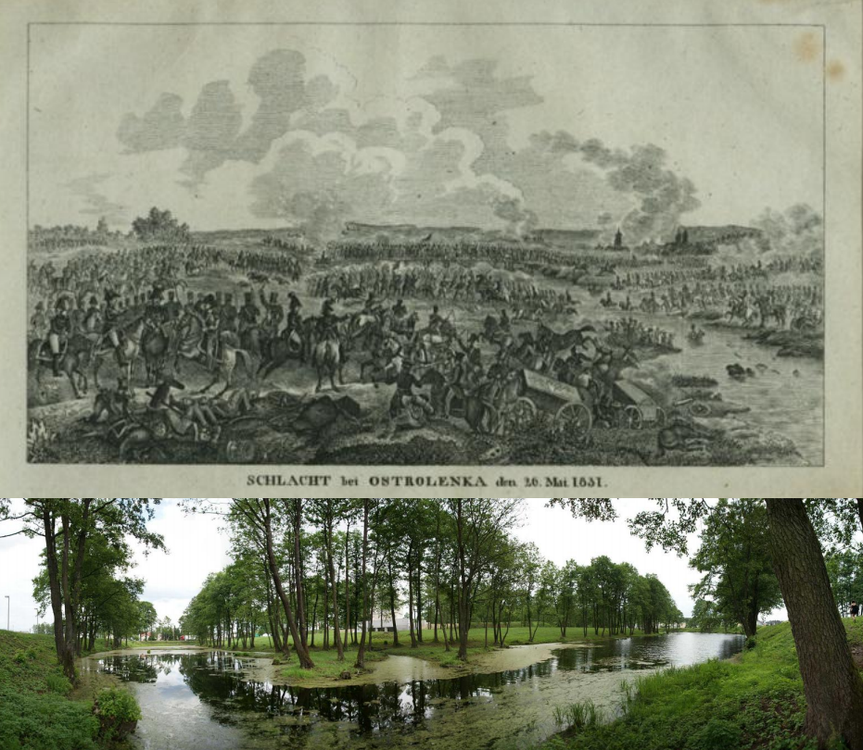

Slide 5
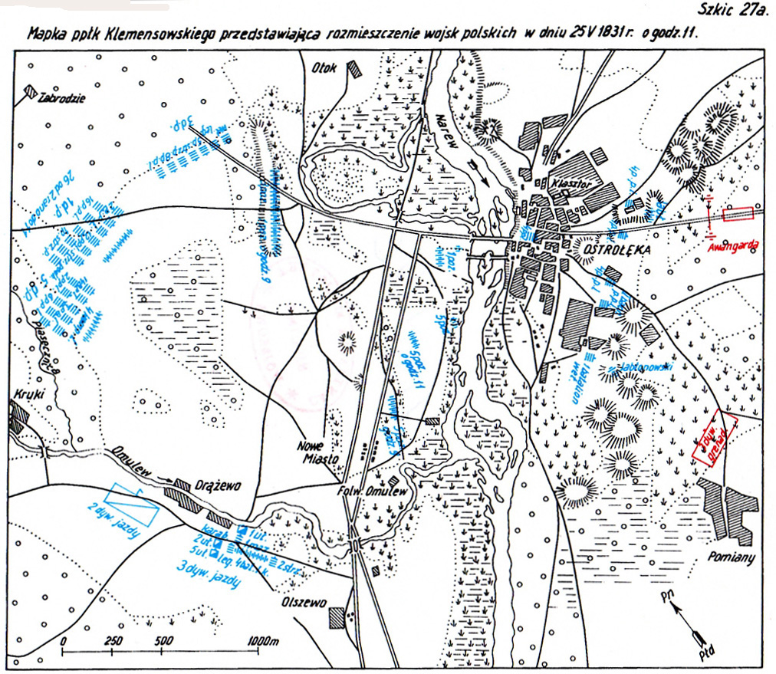
Stage I:
9.00-11.00 AM retreat of Polish guard forces to Ostrołęka against the attack of the Russians (1)
and mobilization of surprised Skrzynecki's main forces (2),
defense of the city and monastery (3),
and finally retreat to the west bank of Narew river (4).

Slide 6
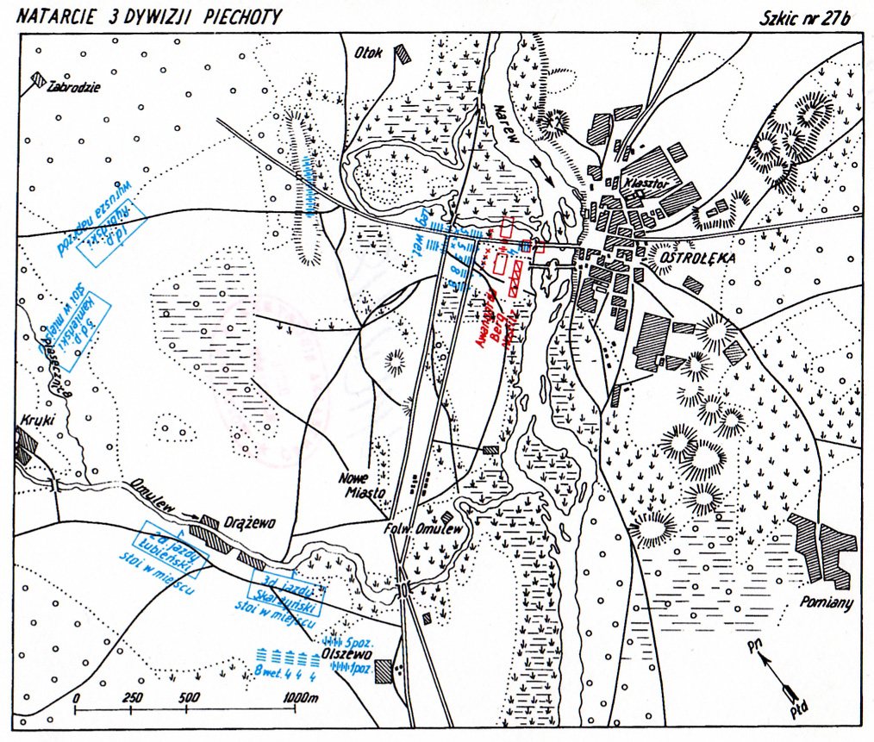
Stage II:
The crossing of the Astrakhan grenadiers and guard grenadiers supported by numerous Russian artillery and the creation of a foothold on the west bank (1), which caused chaos in the Polish ranks deepened by the strong fire of Russian artillery and uncoordinated attacks by the Polish 3rd Division. Infantry (2).

Slide 7
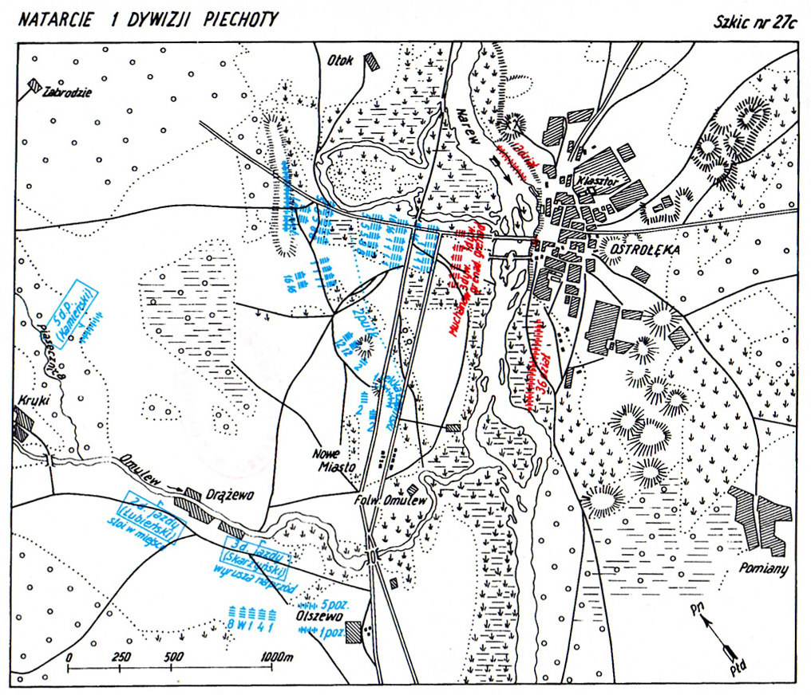
Stage III:
at 1.00 PM successful attack of the Polish 1st division Infantry (1) ended with displacement of the Russians up to the bridges of the Narew River (2) stopped by effective fire of Russian artillery (3)

Slide 8
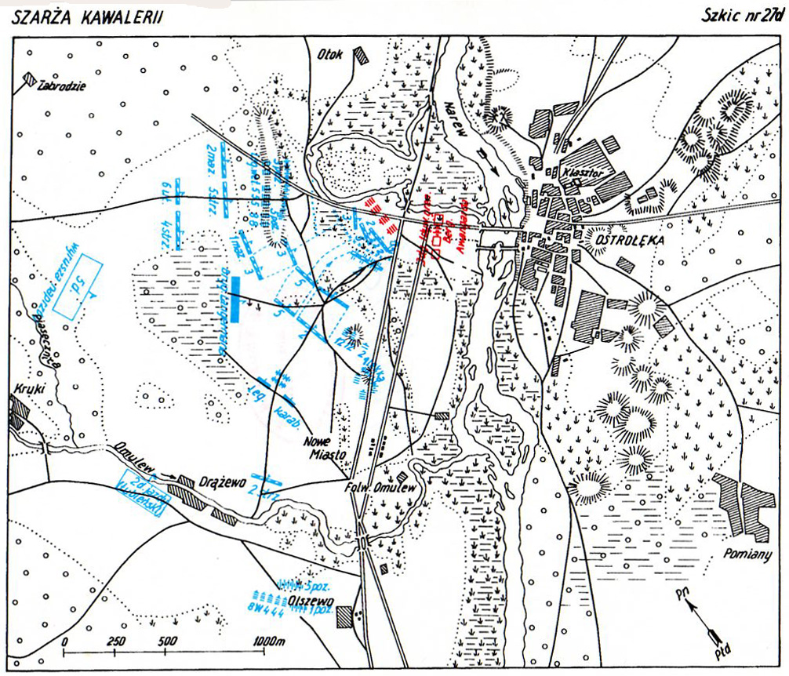
Stage IV:
2.00-3.00 PM attack of the 2nd and 5th Uhlans Regiment failed (1) and the death of Gen. Kicki (2) at 4.00PM Russians repair bridges to carry out the main attack (3).

Slide 9
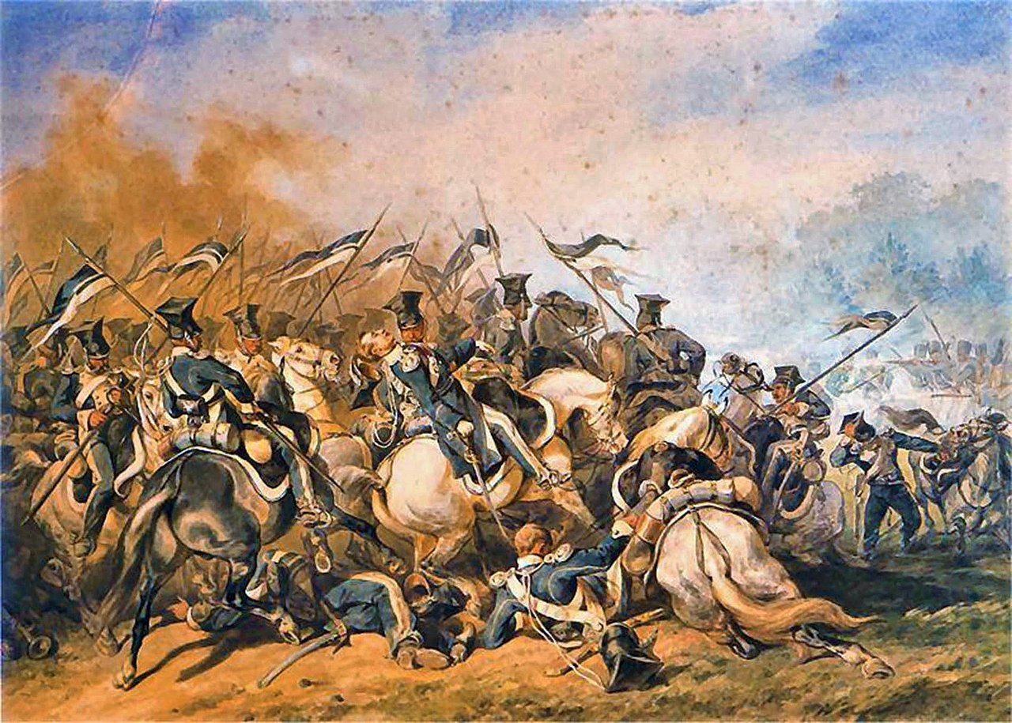

Slide 10
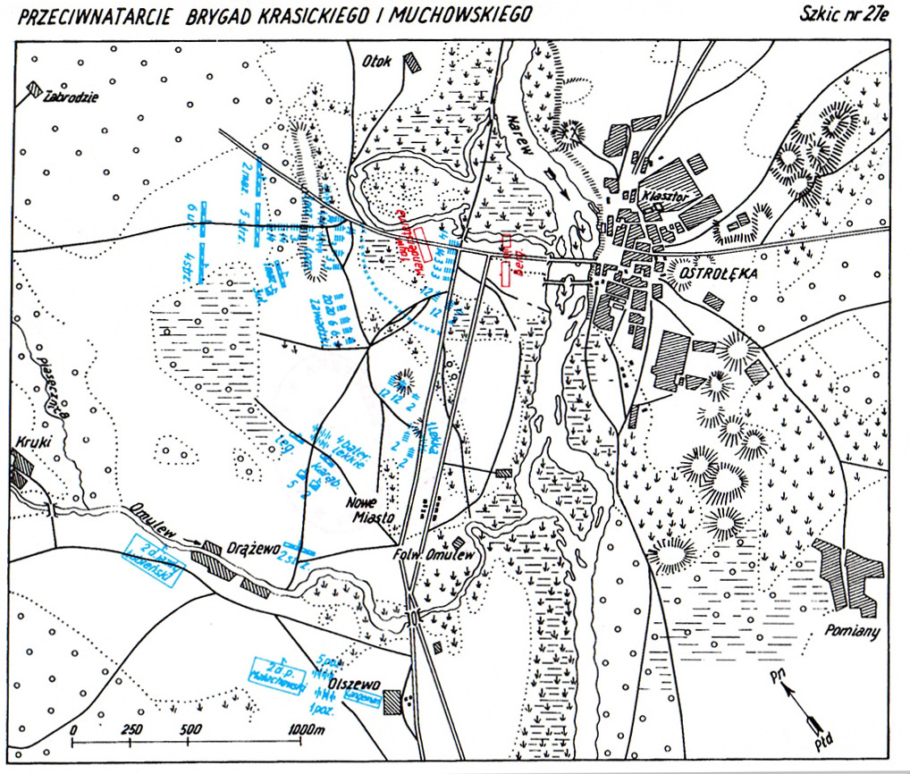
Stage V:
4.00PM Crossing of subsequent Russian forces (1) which at 5.00PM lead a failed attack on Poles, which causes panic in the Russian ranks and the threat of its collapse (2). Thanks for arriving at 18.00 Russian support forces managed to prevent the Russian defeat, but the positions were still threatened by Poles (3).

Slide 11
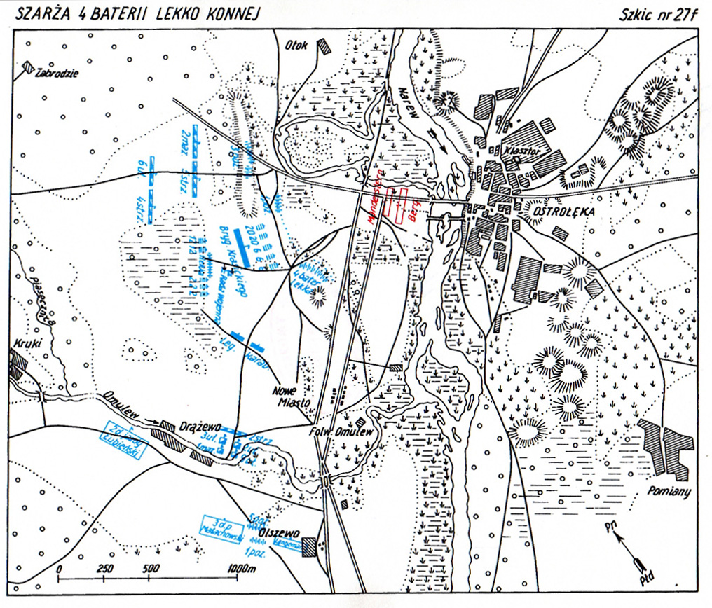
Stage VI:
at 7.00PM transferred the Russian Commander-in-Chief Gen. Ivan Dibicz on the west bank of the Narew river, thanks to which panic was under control (1) Meanwhile, on the Polish side, there were no more reserves (2) so under the cover of light infantry set up in the loose lines they tried to regroup the remaining Polish regiments, but in the event of a attack, the Polish army would be defeated (3). To prevent a Russian attack, so-called the "charge" of 4 light battery of Gen. Józef Bem, which with accurate firing prevented the Russians from launching the final attack (4) and enabled the organized retreat of the Polish army, saving it from destruction.

Slide 12
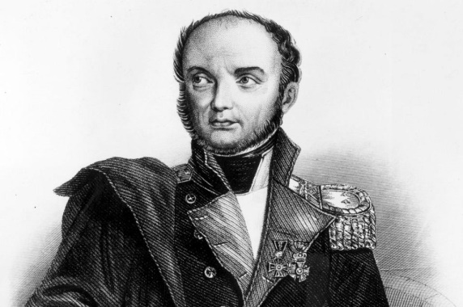
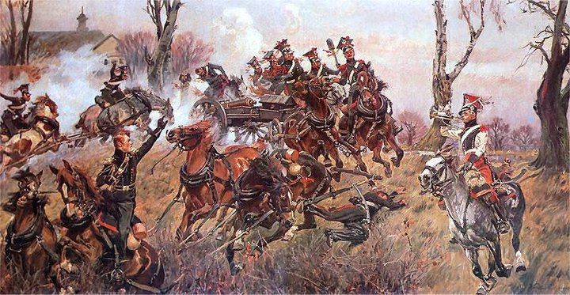
After the battle
Polish losses amounted to 194 officers and 6224 soldiers killed, injured or taken prisoner
Russian losses amounted to 172 officers and 5696 soldiers.
Due to the ignorance of the situation among the opponents, both sides initially considered the battle to be lost(!).
However, it was a turning point of the Polish-Russian war. Poles have lost the initiative and despite their local successes, they were no longer able to repel the second Russian offensive on Warsaw, which capitulated on September 8, 1831.

