Slide 1
KATYN AS A PLACE OF MEMORY: CHANGE OF MEANINGS OF THE MEMORIAL IN THE PROCESS OF ITS RECONSTRUCTION IN 2017-2018
Arseniy Kazantsev

Slide 2
Historical excursus to the place of tragic memory
KATYN AS A PLACE OF MEMORY: CHANGE OF MEANINGS OF THE MEMORIAL IN THE PROCESS OF ITS RECONSTRUCTION IN 2017-2018
Katyn
The Russian Federation, 20 km from the center of Smolensk
The place of execution and burial of Polish prisoners of war in 1940 and the place of burial of repressed Soviet citizens in the 1930s

Slide 3
KATYN AS A PLACE OF MEMORY: CHANGE OF MEANINGS OF THE MEMORIAL IN THE PROCESS OF ITS RECONSTRUCTION IN 2017-2018
The purpose: to identify new meanings and values that have appeared after reconstruction of the Katyn memorial 2017-2018.
Tasks:
1. to show the forms of historical narrative reflected in the complex artifacts presented in Katyn;
2. to complete a diachronic comparison according to the periodization;
3. to identify the changes of the meanings and values of Katyn.

Slide 4
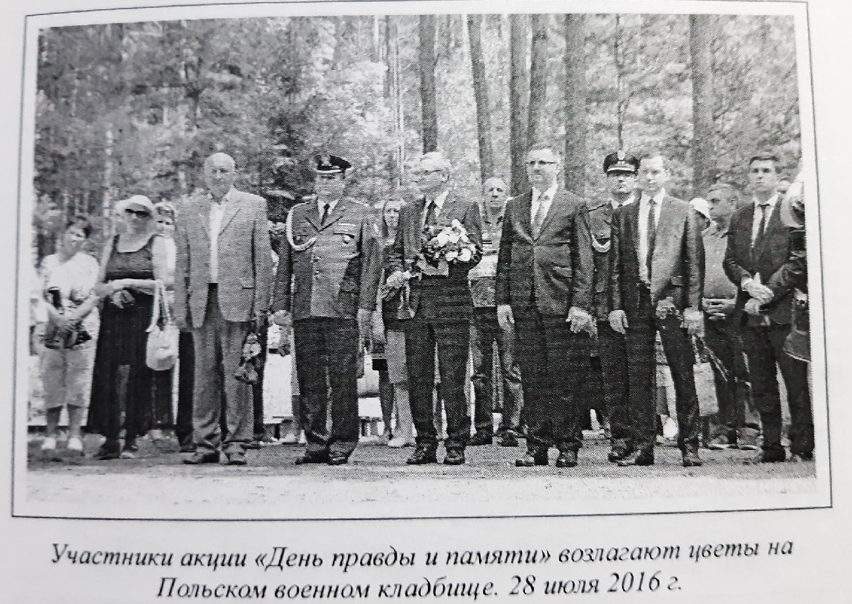
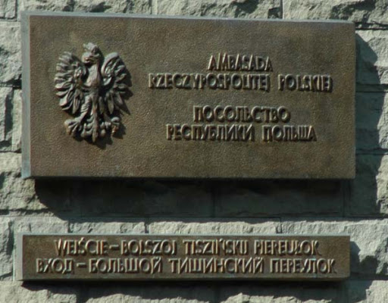
The author’s approaches
KATYN AS A PLACE OF MEMORY: CHANGE OF MEANINGS OF THE MEMORIAL IN THE PROCESS OF ITS RECONSTRUCTION IN 2017-2018
actor-oriented
institutional- oriented
local-oriented

Slide 5
Method and methodology
KATYN AS A PLACE OF MEMORY: CHANGE OF MEANINGS OF THE MEMORIAL IN THE PROCESS OF ITS RECONSTRUCTION IN 2017-2018
The comparative – historical method:
a diachronic comparison (periodization, actors, etc.);
The “Dynamic-communicative” methodology by Bernhard and Kubik
Identification,
typologization,
description of “mnemonic actors” as well as “mnemonic regimes”, i.e. memory regimes.

Slide 6
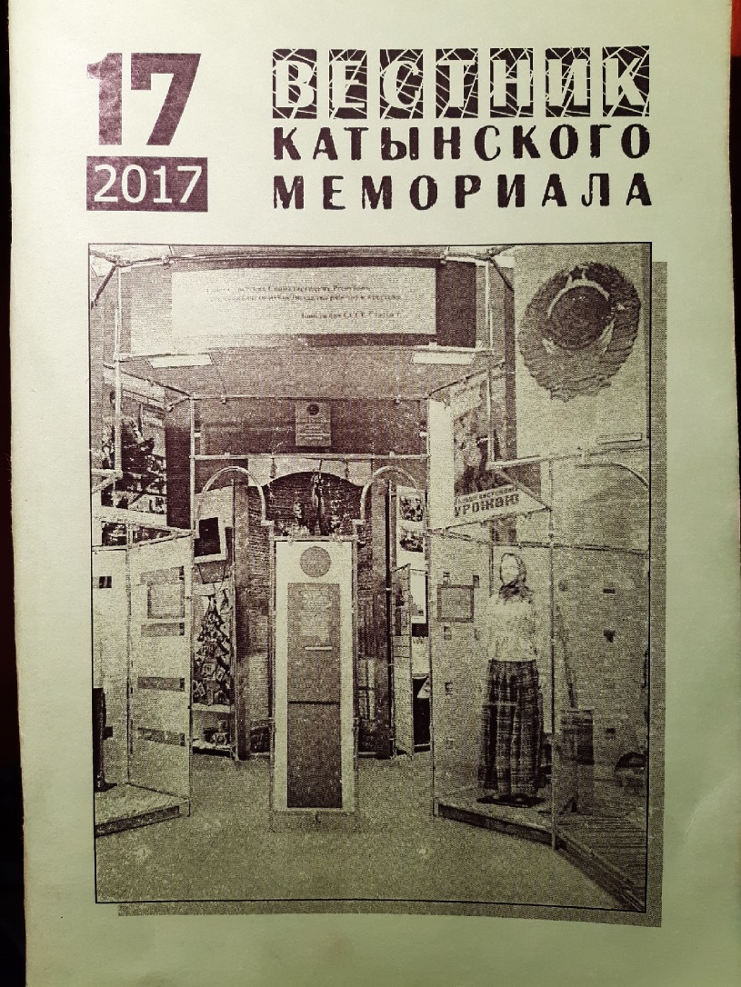
MAIN SOURCES [KATYN]
KATYN AS A PLACE OF MEMORY: CHANGE OF MEANINGS OF THE MEMORIAL IN THE PROCESS OF ITS RECONSTRUCTION IN 2017-2018
Author's archive of photo documents - "Katyn 12.02.2020”
"Bulletin of the Katyn memorial": №12 (2012), №13 (2013), №15 (2015), №17 (2017)
Russian-language and English-language booklets for memorial visitors

Slide 8
MAIN SOURCES [KATYN]
KATYN AS A PLACE OF MEMORY: CHANGE OF MEANINGS OF THE MEMORIAL IN THE PROCESS OF ITS RECONSTRUCTION IN 2017-2018
Author's archive of photo documents - "Katyn 12.02.2020”
"Bulletin of the Katyn memorial": №12 (2012), №13 (2013), №15 (2015), №17 (2017)
Russian-language and English-language booklets for memorial visitors

Slide 9
The meaning of the concept – Patriotism (from the “Bulletin of the Katyn memorial”)
Khachaturova, № 13, 2013
Khachaturova, №15,2015
Real patriotism and development of the Russian society are impossible “without understanding of the tragic experience of Russia in the XX century.
< ... > Hiding the truth about the past deprives us of the possibility of national self-esteem”
“Patriotism < ... > is a moral and political principle, a social feeling, the content of which is love for the Fatherland and a willingness to subordinate their private interests to its interests”

Slide 10
“Concept of the exhibition “Katyn. 1940. Katyn crime: history and modernity. (Andreenkova G, Kornilov O., Aleksandrov V., 2012)
“The new exhibition must contribute to the development of historical memory in Russian society connected with the shooting of almost 22000 Polish citizens in various parts of the USSR in 1940”
The exhibition focused on the fate of a particular person, and its “main characters are victims of the Katyn crime: Polish officers and civil people”

Slide 11
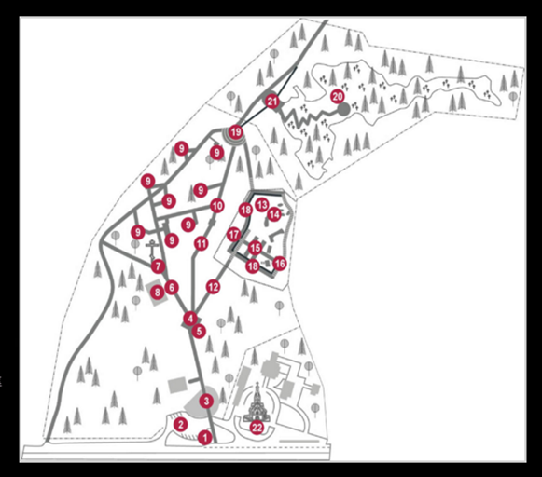
DIACHRONIC COMPARISON OF THE PLACE OF TRAGIC MEMORY: KATYN
KATYN AS A PLACE OF MEMORY: CHANGE OF MEANINGS OF THE MEMORIAL IN THE PROCESS OF ITS RECONSTRUCTION IN 2017-2018
(Representation of the tragedy of Polish soldiers)
Exhibition in the Pavilion of the main entrance.
The first ritual site.
Exhibition in the new
Museum and exhibition complex.
2017-2018 – setting the "disconnected regime" of memory: actor “pluralist”– The Polish official delegation, actor “warrior” – РВИО/ГЦМСИР

Slide 12
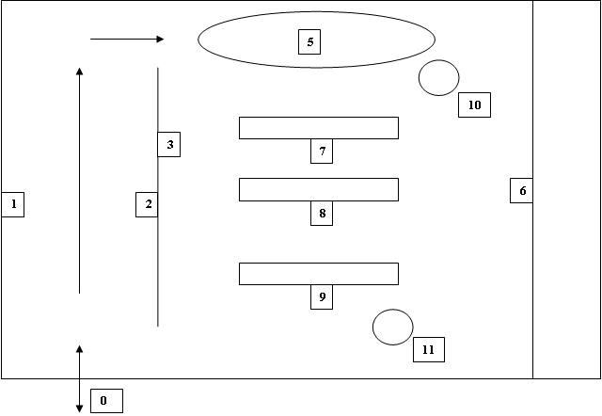
Structure of exhibition in the Pavilion of the main entrance
KATYN AS A PLACE OF MEMORY: CHANGE OF MEANINGS OF THE MEMORIAL IN THE PROCESS OF ITS RECONSTRUCTION IN 2017-2018
1,2 – gallery of memory
3 – documents
6 – repressed people by the Soviet government from 1918 to 1937-1938 on the territory of the “Smolensk region”
7,8 – stands with information and things of repressed Soviet citizens
9 – stands with information and things of repressed Polish citizens
10, 11 – multimedia posts

Slide 13
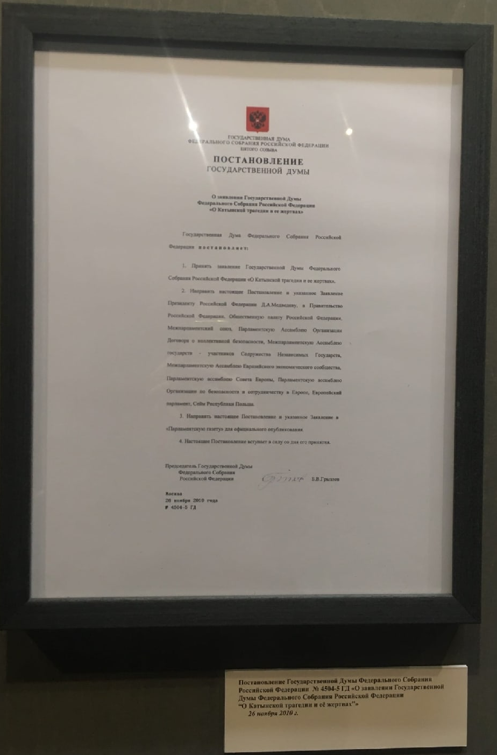
Object 3. "Resolution of The State Duma of Russia” 2010
KATYN AS A PLACE OF MEMORY: CHANGE OF MEANINGS OF THE MEMORIAL IN THE PROCESS OF ITS RECONSTRUCTION IN 2017-2018

Slide 16
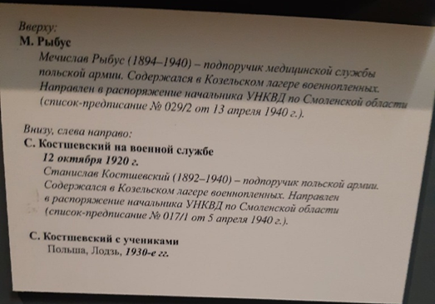
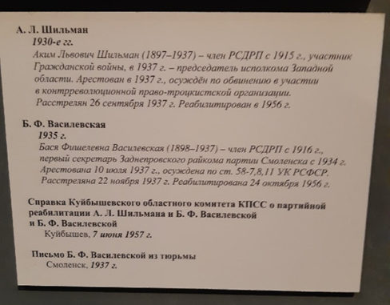
Standard biographical information on stands dedicated to Polish and Soviet prisoners of war
KATYN AS A PLACE OF MEMORY: CHANGE OF MEANINGS OF THE MEMORIAL IN THE PROCESS OF ITS RECONSTRUCTION IN 2017-2018
№7 | №9
Mieczyslaw Rybus (1894-1940) was a sub-lieutenant of the medical service of the Polish army. He was in the Kozelsk prison camp and sent to the order of the chief of the NKVD for the Smolensk region (list-order No. 029/2 of April 13, 1940) (Highlighted by me - Kazantsev) | Basia Fishelevna Vasilevskaya (1898-1937) was a member of the RSDLP since 1916, the first Secretary of the Zadneprovsky district party Committee of Smolensk since 1934. She was arrested on July 10, 1937 and convicted under the articles 58-7, 8, 11 of the RSFSR criminal code. She was shot on November 22, 1937 and rehabilitated on October 24, 1956 (Highlighted by me - Kazantsev)

Slide 17
Structure of exhibition in the Pavilion of the main entrance
KATYN AS A PLACE OF MEMORY: CHANGE OF MEANINGS OF THE MEMORIAL IN THE PROCESS OF ITS RECONSTRUCTION IN 2017-2018
1,2 – gallery of memory
3 – documents
6 – repressed people by the Soviet government from 1918 to 1937-1938 on the territory of the “Smolensk region”
7,8 – stands with information and things of repressed Soviet citizens
9 – stands with information and things of repressed Polish citizens
10, 11 – multimedia posts

Slide 18
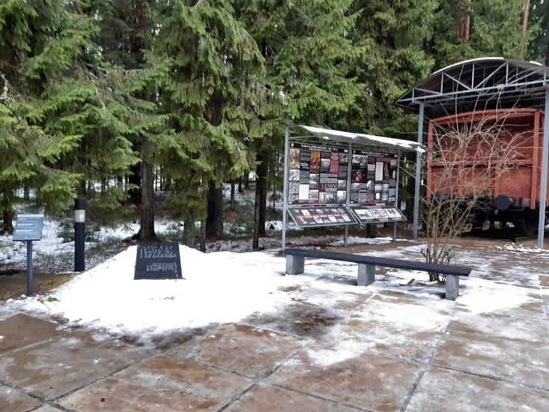
The first ritual site

Slide 19
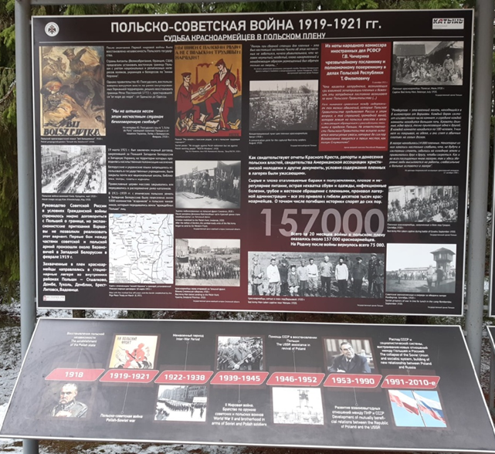
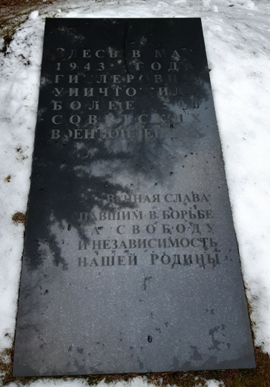
In May of 1943 the Nazis destroyed more than 500 Soviet prisoners of war here.
Eternal glory to those who fell in the struggle for freedom and independence of the Motherland.

Slide 20
Exhibition in the new Museum and exhibition complex
KATYN AS A PLACE OF MEMORY: CHANGE OF MEANINGS OF THE MEMORIAL IN THE PROCESS OF ITS RECONSTRUCTION IN 2017-2018

Slide 21
New meanings (значения)
KATYN AS A PLACE OF MEMORY: CHANGE OF MEANINGS OF THE MEMORIAL IN THE PROCESS OF ITS RECONSTRUCTION IN 2017-2018
Presence of the unscientific "Soviet" version (Burdenko Commission 1944) of the tragedy (death) of Polish soldiers in Katyn in the exhibition of Pavilion of the main entrance.
Creation of a hostile image of Poland among Russian-speaking visitors to Katyn (an exhibition at the first ritual site).
Displacement (вытеснение) of guilt for the Katyn crime among Russian-speaking visitors of the memorial
New values (смыслы)
The "memory frameworks" of narrative in the Pavilion of the main entrance have been expanded, a new exhibition is devoted to the Soviet penitentiary system since 1918.

