Slide 1
Activities of societies of aid to Polish refugees for the preservation of their national identity during the First world war
Vladimir Komarov
Moscow, 2020

Slide 2
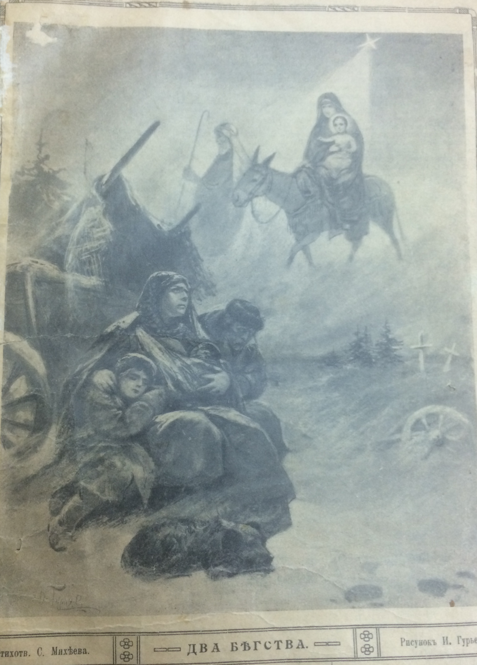

Slide 3
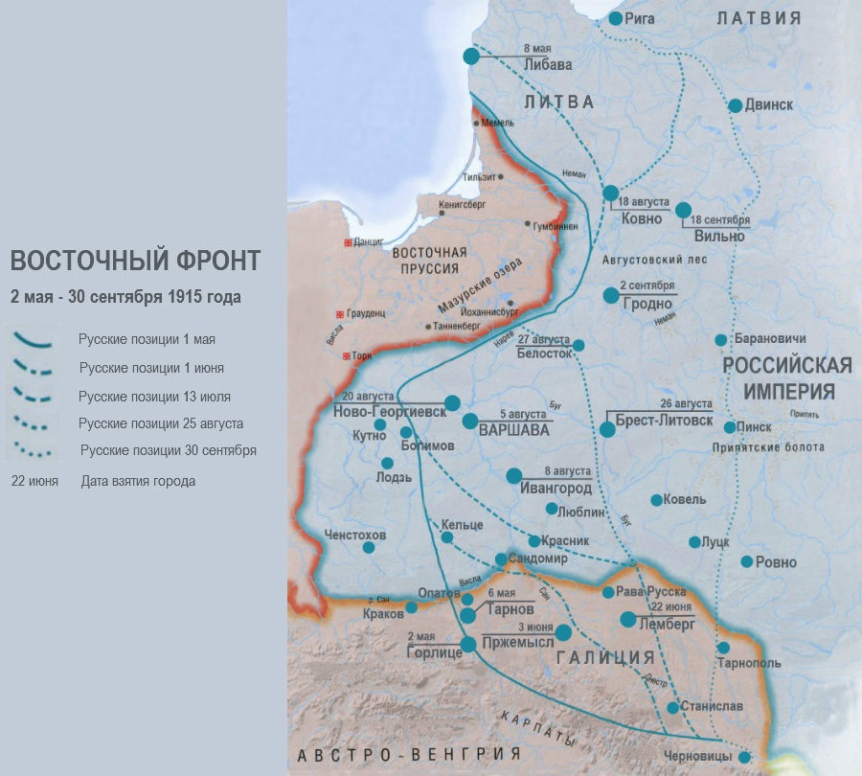
The Eastern Front in May-September 1915

Slide 4
Funding of societies:
Before autumn 1915 - private donations
After September-October 1915 - government funding

Slide 5
The main types of aid to refugees:
Financial
Material
Fuel
Housing
Cultural

Slide 6
The "origins" of societies of aid to
Polish refugees
Charity organisations
Religious associations
Church
“What a happiness it was: Jesus, hidden in the holy mysteries, the altar of the Mother of God, the priest, several chaplains from Polish emigrants - everything is the same as at home, in Warsaw”.

Slide 7
Societies of aid to Polish refugees
“Their appearance was a phenomenon that had no analogues in pre-war history, testifying to the severity of the refugee problem, as well as to the disbelief of representatives of a number of ethnic communities (Jews, partly Poles) in the ability of Russian government structures and Russian population to support their compatriots who have fallen into difficult conditions. ”
A.S. Tumanova

Slide 8
Key directions of cultural support
Theaters
Literature evenings
Charity concerts
Lectures (on Polish literature, culture, history)

Slide 9
Distinctive features of Polish societies
Targeted nature of support programs - exclusively to Poles,
Emphasis on educational organization (both for children and adults)
Significant religious component
Great attention to the cultural and spiritual needs of refugees

Slide 10
The presence of Poles from all regions in Russia during the First World War made it possible to simulate a meeting in independent Poland, where the divided for a long time Polish nation was to be consolidated once again
Горизонтов Л.Е. Метаморфозы идентичности поляков в России в период Первой мировой и гражданской войн

