Slide 1
verbal root structure and aspect in dargwa
This research has been supported by the Russian Scientific Foundation, grant No. 22-28-01648.
Nina Sumbatova, Higher School of Economics
First international conference on the languages of the Anatolia-Caucasus-Iran-Mesopotamia area.
November 16--18, 2022, INALCO, Paris

Slide 2
outline
information on Dargwa
genetic, areal and typological info
verbal root structure
aspect
diagnostic suffixes
questions and problems
database description
answers (?)

Slide 3
Dargwa
Nakh-Dagestanian (East Caucasian) family
approximately 500,000 speakers
Central and Eastern part of Dagestan (Russian Federation)
well-known for dialectal divergences
ergative, left-branching, free word order
rich nominal and verbal morphology
gender and person agreement

Slide 4
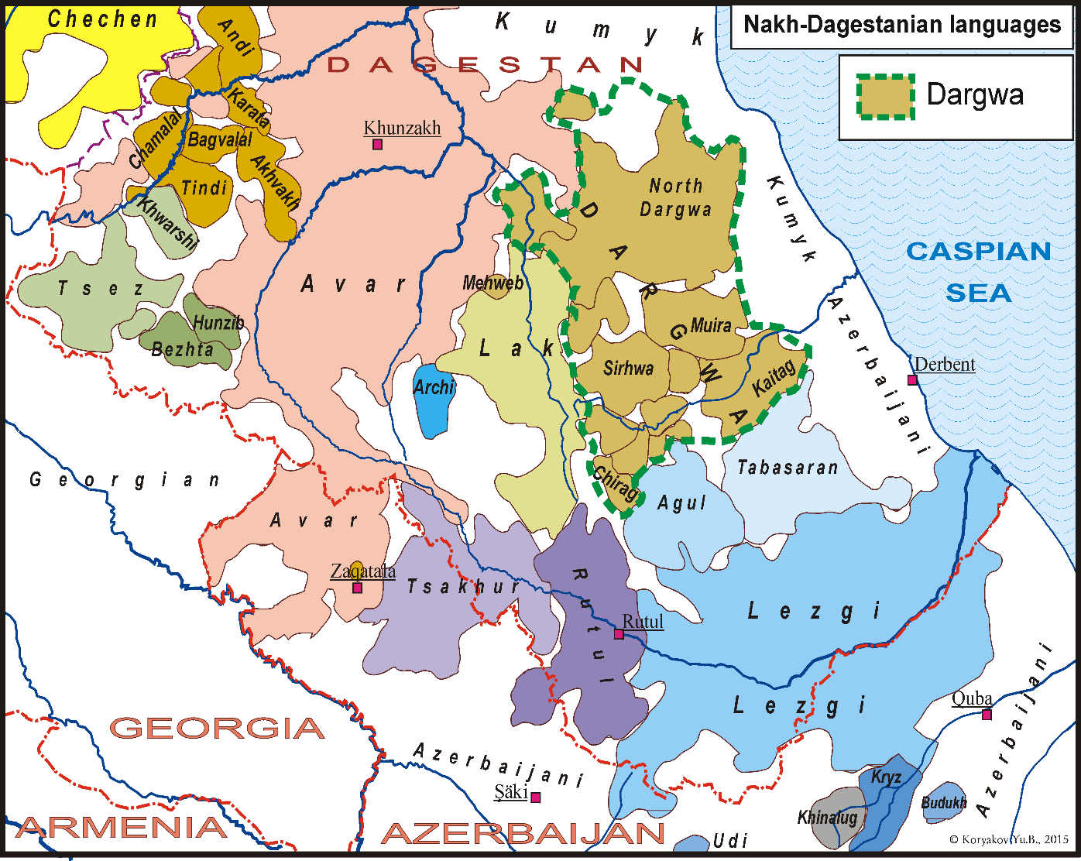
Dargwa

Slide 5
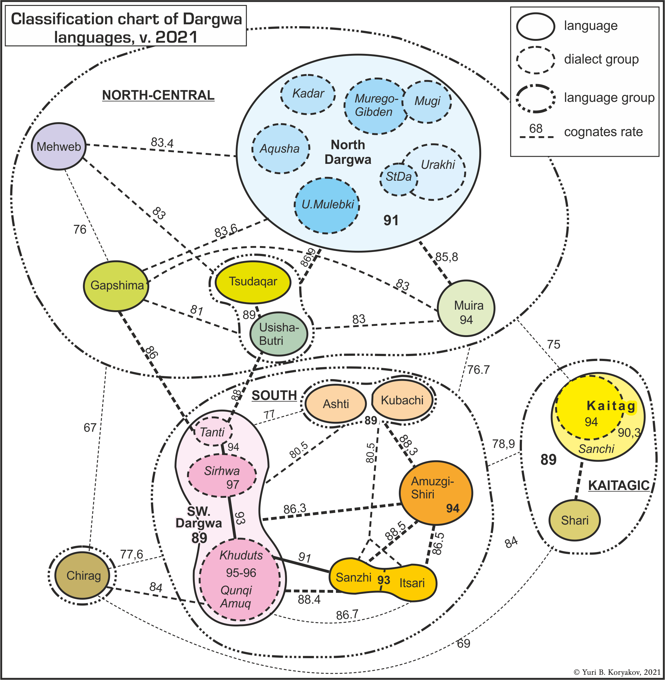
Dargwa: a language or a language group?
Koryakov 2021:
15 languages and many dialects
Diverged in II-III century BC
I treat Dargwa as a language group and will discuss the Dargic languages.

Slide 6
Simple and derived verbs
Root: (GENDER-)ROOT b-irč ‘fall’
Simple verbs: (GENDER-)ROOT + inflectional affixes b-irč-iž ‘fall’
Derived verbs:
+ causative suffix b-irč-aq-iž ‘drop’
+ preverb(s) gu-tːi-b-irč-iž ‘lose’ (gu- ‘under’ + tːi- ‘behind’)
+ additional lexical stem han-b-irč-iž ‘remember’ (han is a root)
(examples from Tanti Dargwa)

Slide 7
verbal root structure
possible root structures:
VC, CL-VC
VRC, CL-VRC
RVC
C – any consonant, V – any vowel, R – «sonorant»: {r, l, m, b, š, ž, w, j}
200-250 verbal roots per language/dialect

Slide 8
verbal root structure: examples (Muiri)
Meaning | Root: IPFV | Root: IPFV | Infinitive IPFV
‘sew’ | VC | ipː | ipː-ara
‘say’ | CL-VC | CL-ik'ʷ | b-ik'ʷ-ara
‘throw’ | VRC | irhʷ | irhʷ-ara
‘find’ | CL-VRC | CL-urk: | b-urk:-ara
‘write’ | RVC | luk’ | luk'-ana

Slide 9
aspect
Most verbal roots exist in two variants: perfective and imperfective.
The opposition of these two variants expresses the category of aspect.
This category characterizes verb forms, not whole lexemes.
Muiri Dargwa
(1) a. b-aq’-ib b. b-iq’-u-li=sa‹b›i
N-hear.PFV-AOR N-hear.IPFV-PRS-CVB=COP‹N›
‘(he) heard (that)’ ‘(he) hears (that)’
(2) a. b-aq’-ab b. b-iq’-ab
N-hear.PFV-OPT N-hear.IPFV-OPT
‘let (him) hear (PFV)’ ‘let (him) hear (IPFV)’

Slide 10
aspect
The two variants of a root show common phonological features but their relationship is highly irregular.
Meaning | Root: PFV | Root: IPFV | Infinitive PFV/IPFV
‘find’ | CL-ark: | CL-urk: | b-ark:-ara/b-urk:-ara
‘write’ | CL-elk' | luk’ | b-elk'-ana/luk'-ana
‘throw’ | ihʷ | irhʷ | ihʷ-ara/irhʷ-ara
‘thresh’ | CL-irq- | iq- | d-irq-aˁra/iq-aˁra
‘sew’ | CL-epː | ipː | b-epː-ara/ipː-ara
‘sow’ | CL-aʡ | CL-alʡ | b-aʡ-ana/b-alʡ-ana
‘measure’ | umc | umc | umc-ara/umc-ara

Slide 11
aorist markers and other diagnostic suffixes
In most languages of the group, verbs fall into three inflectional classes. These classes are manifested in the choice of certain inflectional affixes, first of all the aorist markers.
Tanti Dargwa
a. b-arčː-ib ha-b-iq’-ur b-elčʼ-un
n-find.pfv-aor up-n-light.pfv-aor n-read.pfv-aor
‘(he) found (it)’ ‘(he) lit (it) up’ ‘(he) read (it)’
b. b-určː-u-le ha-b-ilq'-u-le b-učʼ-un-ne
n-find.ipfv-prs-cvb up-n-light.ipfv-prs-cvb n-read.ipfv-prs-cvb
‘(he) is finding (it)’ ‘(he) is lighting (it) up’ ‘(he) is reading (it)’
c. b-arkː-ab ha-b-iq'-ab b-elčʼ-ab
n-find.ipfv-prs-cvb up-n-light.ipfv-prs-cvb n-read.ipfv-prs-cvb
‘let (him) find’ ‘let (hin) light up’ ‘let (him) read (it)’

Slide 12
aorist markers as a trace of “root determiners”
The diagnostic suffixes (“root determiners”) show correlation with the root sonorants (Mudrak 2016: 72–79):
VlC-(V)n
VrC-(V)r
Muiri:
arc-ur ‘fly-AOR’
b-elč’-un ‘read-AOR’

Slide 13
questions to be discussed
is the structure of cognate verbal root the same in different languages of the Dargwa group?
are the vowels and sonorants of a certain verbal root the same in different languages of the group? (do they correspond in a regular way?)
do the elements of a certain comparative series attach the same diagnostic markers?
is there a correlation between the root sonorants and root determiners (aorist markers)?
what are the possible and the most common formal types of aspectual oppositions?
can we classify the verbal roots as to the type of aspectual opposition?
can we figure out the historical direction of aspectual derivation at least for a part of verbal roots? is this direction the same for all verbs?
A further task is to understand how the modern aspectual system appeared and developed in the languages of the Dargwa group.

Slide 14
database: 9 languages
Standard Dargwa [based on Aqusha]: [Yusupov 2017], 40000 entries
Kubachi: [Magomedov, Saidov-Akkutta 2017], appr. 7000 words
Tanti: lexicon from [Sumbatova, Lander 2014] with additions; appr. 1400 entries, 450 verbs
Itsari: lexicon from [Sumbatova, Mutalov 2003] + a lexicon collected by Rasul Mutalov (appr. 1100 entries, 320 verbs)
Kadar: lexicon collected by Naida Vagizieva (unpublished), appr. 1800 entries, 666 verbs
Chirag: verbs from [Kibrik, Kodzasov 1988], 220 lexical meaning
Mehweb: [Musaev, Morozova, Daniel 2020], appr. 1100 entries, 290 verbs
Muiri: fielddata (2018—2021); appr. 1400 entries, 390 verbs
Kajtag: [Gasanova 2011], appr. 4300 words

Slide 15
database
all verbal roots found in the sources
170 comparative series (=series of cognate roots)
each root attested in at least three languages
clear semantic correspondences between roots in different languages
for each root (PFV/IPFV): root structure, presence of a gender marker, vowel V, sonorant R, aorist marker
 |  |  |  |  |  |  | Kajtag |  |  |  |  |  | Aqusha |  |  |  |  |  |  | Muira
2237 | +/+ | AC/ARC | i/i | l | un | lie | CL-isː | CL-ilsː | AC/ARC | +/+ | */l | i/i | CL-is | CL-ils | AC/ARC | +/+ | */l | i/i | un | CL-is | CL-ils | AC/ARC | +/+ | */l | i/i | un
2026 | +/+ | ARC/URC | a/u | m, r | ur | get tired | CL-arcː | urcː | ARC/URC | +/- | r/r | a/u | CL-ams | CL-ums | ARC/URC | +/+ | m/m | a/u | ur | CL-ams | ums | ARC/ URC | +/- | m/m | a/u | ur
2101 | +/- | ARC/UC | i/i | r | ib | shave | CL-irsː | isː | ARC/AC | +/- | r/* | i/i | CL-irs | irs | ARC/ARC | +/- | r/r | i/i | ib | CL-ers | CL-usː | ARC/UC | +/+ | r/* | e/u | ib
2012 | -/- | AC/UC | a/i | * | ib | buy | asː | ursː | AC/URC | -/- | */r | a/u | as | is | AC/UC | -/- | */* | a/i | ib | asː | isː | AC/UC | -/- | */* | a/i | ib

Slide 16
questions and answers
is the structure of cognate verbal roots the same in different languages of the Dargwa group?
YES: 94 of 170 roots have the same structure in all languages of the sample, most other roots have 1-2 deviating roots
are the vowels and sonorants of a certain verbal root the same in different languages of the group? (do they correspond in a regular way?)
do the elements of a certain comparative series attach the same aorist markers?
YES: in most cases, the roots within a comparative series show the same (phonologically corresponding) vowels and sonorants and attach corresponding aorist markers
This means that the root structure and the aspectual system that we observe now was formed by the Proto-Dargwa level or even earlier.

Slide 17
questions and answers
is there a correlation between the root sonorants and “root determiners” (aorist markers)?
Sonorant |  | Number of verbal roots |  | Aorist marker
 | PFV/IPFV |  |  | -Vb |  | -ur |  | -un |  | inconsist.
* | */* | 19 |  | 18 |  | 0 |  | 1 |  | 0
r | r/r | 70 | 25 | 55 | 16 | 10 | 8 | 1 | 0 | 4 | 1
 | */r |  | 19 |  | 17 |  | 1 |  | 0 |  | 1
 | r/* |  | 26 |  | 22 |  | 1 |  | 1 |  | 2
l | l/l | 38 | 16 | 2 | 0 | 2 | 0 | 34 | 16 | 0 | 0
 | */l |  | 21 |  | 2 |  | 2 |  | 17 |  | 0
 | l/* |  | 1 |  | 0 |  | 0 |  | 1 |  | 0
m | m/m | 8 |  | 0 |  | 8 |  | 0 |  | 0
b | b/b | 6 |  | 6 |  | 0 |  | 0 |  | 0
š | š/š | 3 |  | 2 |  | 1 |  | 0 |  | 0
l~r | */l ~ */r | 5 |  | 0 |  | 4 |  | 0 |  | 1
 |  | 149 |  | 83 |  | 25 |  | 36 |  | 5

Slide 18
root sonorants and the aorist markers
The diagnostic suffixes show historical correlation with the root sonorants.
sonorant r – aorist marker -Vb (less frequently, -ur) (root determiners Ø or R))
sonorant l – aorist marker -un (root determiner N)
sonorant m – aorist marker -ur (root determiner R)
Proto-East-Caucasian verbal root (Nikolaev & Starostin 1994: 86-89): *(H)V(R)CV(R).
(Proto-)Dargwa verbal root: *(H)V(R)C-(V)R

Slide 19
questions and answers
can we classify the verbal roots as to the type of aspectual opposition?
can we figure out the historical direction of aspectual derivation at least for a part of verbal roots? is this direction the same for all verbs?

Slide 20
root classes in the database
 | Root structure: PFV/IPFV | Number of roots | Gender | Vowels | Sonorants | Aorist markers
A | ARC/URC | 41 | +/+, -/- | a/u, e/u, a/i | any | any
 | AC/UC | 14 | +/+, -/- | a/i | no | -Vb
A’ | ARC/RUC | 10 | +/- | e/u | l/l | -un
B | AC/ARC | 42 | +/+, -/- | (V/V, any V) | */l, */r | any
C C’ | URC/UC | 13 | +/- | i/i, u/u | r/* | -Vb
C’ | ARC/UC | 13 | +/+ | e/u | r/* | -Vb
D | URC/URC | 7 | (any) | i/i, u/u | r/r, m/m, š/š | -Vb
 | UC/UC | 3 | +/+, +/- | i/i | no | -Vb
E | AC | 10 | + | i, u | no | -Vb (-un, -ur)
 | ARC | 5 | + | u | any | different
 | irregular | 6

Slide 21
Roots of the type ARC/URC and AC/UC
a. ‘find’: Muiri, Kajtag, Tantu, Itsari CL-arkː/CL-urkː; Kadar CL-arg/СL-irg; Standard Dargwa, Mehweb CL-arg/CL-urg; Chirag CL-ujkː/CL-ujkː
b. ‘smear’: Standard Dargwa, Kadar, Mehweb, Muiri, Tanti, Itsari, Kajtag, Kubachi CL-ak/CL-ik (Chirag CL-ik/CL-irk)
Vowels: low vowel / high vowel (ARC/URC: a/u, e/u, a/i; AC/UC: a/i)
Sonorants: any
Aorist markers: any
Gender agreement: +/+, -/-

Slide 22
Vowel alternation
PFV ~ IPFV
high vowel / low vowel
Direction of derivation (diachronically): in most cases, the vowel of the IPFV root is determined by the root structure; this is not true for the PFV vowels.
Vowel narrowing: PFV → IPFV

Slide 23
Roots of the type ARC/RUC
many cases of variation: ulC in part of languages, luC in other languages
alC/luC, elC/luC (16 roots)
a. ‘write’: Standard Dargwa, Kadar, Mehweb, Muiri, Tanti, Chirag, Itsari, Kajtag CL-elk'/luk’
b. ‘cook’: Standard Dargwa, Kadar, Muiri CL-elx/lux; Chirag, Tanti, Itsari CL-elxːʷ/luxː; Kajtag CL-elx (PFV); Mehweb CL-erx/CL-urx
c. ‘arrange’: Kajtag CL-alg (PFV); Standard Dargwa, Muiri, Chirag CL-alg/CL-ulg; Itsari, Kubachi CL-alg/lug
Vowels: e/u, a/u
Sonorant: l
Aorist marker: -un
Gender agreement: +/- (-/-)

Slide 24
Metathesis in the IPFV
Metathesis was a recent phonological process ulC → luC, present in all languages, but with different conditions
Itsari and Kadar: in all roots of the type alC, elC
Tanti, Muiri: in all roots of the type elC, but not in the roots alC
Chirag: the same + no metathesis in two roots having no preverb and no gender agreement slot.
Kubachi: metathesis in almost all roots (two exceptions)
Standard Dargwa: most verbs, but the rule is not clear
Mewheb and Kajtag: not enough data
The roots of the type ARC/RUC are a subclass of ARC/URC.

Slide 25
roots of the type AC/ARC
Infixation?
Sonorant loss?
Anything else?
IPFV → PFV
loss of the sonorant
CL-irk → CL-ik

Slide 26
sonorant loss
Arguments in favor of this decision:
different sonorants (l, r) and aorist markers (-Vb, -un, -ur)
non-default aorist markers in the PFV roots, where there are no sonorants:
Muiri
a. a-b-uq-un b. a-b-ulq-u-li
up-n-move.pfv-aor up-n-move.ipfv-prs-cbv
‘(it) rose’ ‘rising’
+some language-specific facts

Slide 27
Roots of the type uRC/UC and ARC/UC
a. ‘milk’: Standard Dargwa, Kadar, Mehweb CL-irz/iz; Kajtag, Chirag, Tanti, Itsari CL-ircː/icː (Muiri CL-ercː/icː)
b. ‘tear; mow’: Standard Dargwa CL-erd/ud; Kajtag, Muiri, Chirag, Tanti, Itsari CL-ertː/utː; Kubachi CL-eːtː/CL-utː
URC/UC ARC/UC
Vowels: i/i, u/u (high vowel) Vowels: e/u
Sonorant: r/* Sonorant: r/*
Aorist marker: -Vb Aorist marker: -Vb
Gender agreement: +/- Gender agreement: +/+

Slide 28
Infixation in PFV
Infixation:
IPFV → PFV
infix -r-
‘milk’: icː → CL-ircː (PFV)
+ Analogy: leveling with the roots of the type ARC/URC
c. ‘shave’: Kajtag, Tanti CL-irsː/isː; BUT Muiri, Itsari CL-ersː/CL-usː

Slide 29
roots of the type AC/ARC
a. ‘fall’: Standard Dargwa, Kadar, Mehweb, Muiri, Tanti, Itsari, Kajtag CL-ik/CL-irk
b. ‘move’: Standard Dargwa, Kadar, Mehweb, Muiri, Tanti, Itsari, Kajtag, Chirag, Kubachi CL-uq/CL-ulq
Vowels: any
Sonorant: */l, */r
Aorist marker: any
Gender agreement: +/+, -/-

Slide 30
roots of the type URC/URC
a. ‘sweep’: Kadar CL-iškʷ/iškʷ; Mehweb, Muiri, Tanti CL-ušk/ušk; Standard Dargwa CL-ušk/ (CL-)ušk; Chirag CL-uškː/uškː
b. ‘beat’: Kadar, Kubachi CL-it/CL-it; Standard Dargwa, Chirag, Tanti, Itsari CL-it/it
Reanalysis
URC → URC_{PFV} / URC_{IPFV}

Slide 31
other
RURC
a. ‘tremble, shiver’: Kajtag, Muiri, Tanti, Itsari rurčː (IPFV); Kadar, Mehweb, Standard Dargwa rurž, Kubachi jučː
AC/URC
b. ‘hit’: Kadar, Mehweb, Standard Dargwa, Tanti CL-aˁq/CL-irq; Itsari CL-aˁq/CL-uˁrq; Kajtag CL-aˤq (PFV); Muiri CL-aˁq/CL-aˁrq; Kubachi CL-aˤq/ CL-uˤq
C
c. ‘give’: Kajtag CL-ekː/lukː, Kadar, Mehweb g/lug, Muiri, Itsari CL-ikː/lukː, ilkː, Chirag CL-ikː/ikː; Tanti kː, CL-ikː/lukː; Kubachi CL-ikː/lukː
d. ‘say’: Kadar, Mehweb, Standard Dargwa, Chirag, Tanti, Kubachi ʔ (СВ), Itsari CL-iʔ/CL-ir(ʔ)

Slide 32
hypothesis on the origin of aspect in dargwa
Root | PFV |  | Initial stem |  | IPFV
A(R)C/U(R)C, ARC/RUC |  |  | A(R)C | > | U(R)C (+ulC > luC)
AC/ARC | AC | < | ARC
URC/UC, ERC/UC | UrC (> erC) | < | UC
U(R)C/U(R)C | U(R)C | < | U(R)C | > | U(R)C

Slide 33
hypothesis on the origin of aspect in dargwa
PFV | (neutral) | IPFV
 |  | U(R)C
AC
UrC
A(R)C
ARC
UC
U(R)C
U(R)C

Slide 34
arguments pro
Almost all theoretically possible root structures allow both perfective and imperfective derivation.
The perfectivization rules are close to complementary distribution:
no sonorant: infixation ~ m, š, r: cleavage ~ l, r: sonorant loss
Typological parallels (Wiemer & Seržant 2017)
The model explains most cases of variation between the Dargwa languages

Slide 35
arguments pro
The model explains most cases of variation between the Dargic languages. For example, the root ‘hit’ has different structures in different languages.
AC/URC: Kadar, Mehweb, Standard Dargwa, Tanti CL-aˁq/CL-irq; Itsari CL-aˁq/CL-uˁrq
AC/ARC: Muiri CL-aˁq/CL-aˁrq
AC/UC: Kubachi CL-aˤq/CL-uˤq
Different derivations for different languages:
Muiri: ARC > AC (CL-aˁrq > CL-aˁq; PFV);
Kubachi: ARC > AC (PFV) and then AC > UC (IPFV)
Other languages: ARC > AC (PFV) and ARC > URC (IPFV)

Slide 36
Thank you!

